Slide 1
Media Matters www.parentmentors.org
A few handy tools and other stuff

Slide 2
The goal is to build a bridge of communication between home and school that leads to more successful outcomes for students.
The GaPMP is currently supported by the Ga DOE Division for Special Education Services and Supports (DSESS).
Local School Districts hire the parent leaders, moms and dads of children with disabilities, to work with families, school teams, teachers, and the community.

Slide 3
Our Media To Do List for Today
Intro to website
Media releases
Find a Mentor pages
Rookie Training Manual
Parent Mentor 101

Slide 4
www.parentmentors.org

Slide 5
Putting Your Program on the Map
Contact Anne Ladd to be put on the listserv
aladd@doe.k12.ga.us
Contact Jane Grillo to be added to the website and access to Learning Curve
jgrillo343@yahoo.com

Slide 6
The Learning Curve
You will create an account. Type in first name and last name and the password that was emailed to you. Then you can change your password. This is your key to the file cabinet.

Slide 7
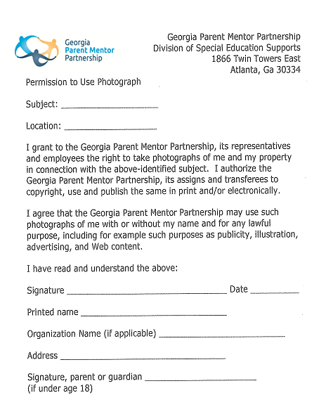
Media Releases
Need one for you
Download off the Learning Curve every time you submit a photo or written content relating to individuals in your district. Email to jgrillo343@yahoo.com

Slide 8
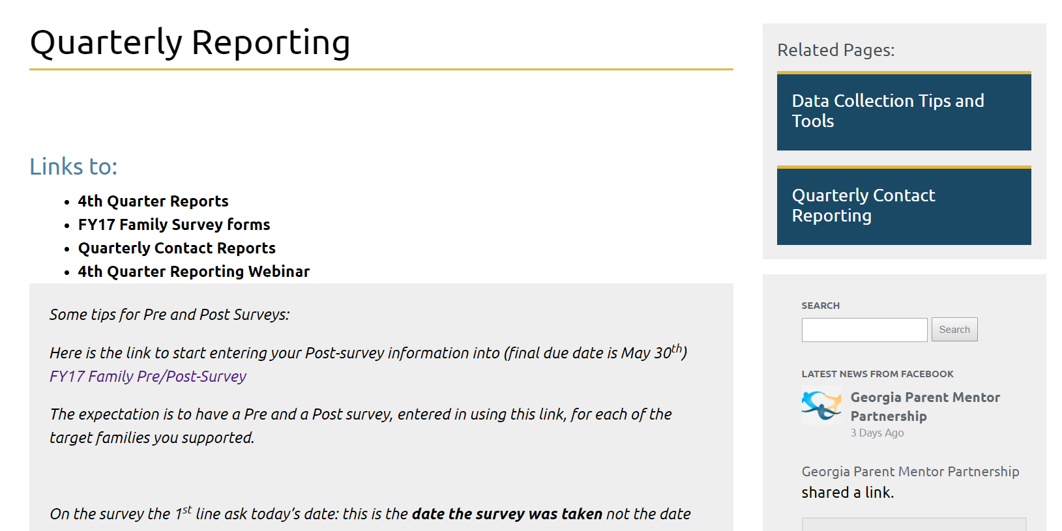
Quarterly Reporting

Slide 9
Who and What Am I Reporting Now?

Slide 10
Find What You Need

Slide 11
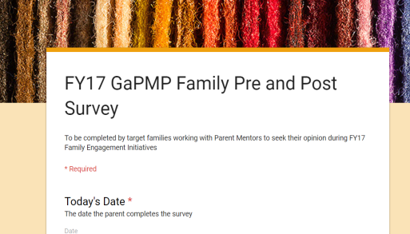
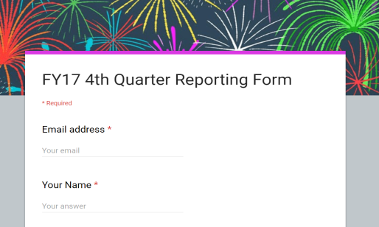
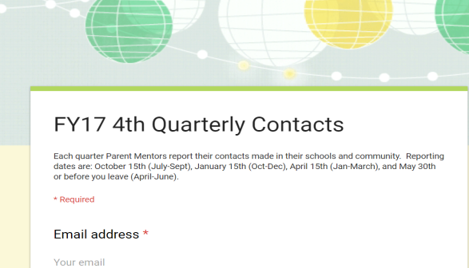
Reports Overview
3 reports
Pre and Post Surveys are completed at the beginning and the end of the year
Two are submitted on Oct. 15, Jan. 15, April 15 and May 30th
Quarterly Reporting (this is about your plan)
Quarterly Contacts (this is about communication)
wo are submitted on Oct. 15, Jan. 15, April 15 and May 30^{t}

Slide 12
I Need More Info

Slide 13
More Learning Tools

Slide 14
Still have questions?
Jane Grillo’s contact info:
Email: jgrillo343@yahoo.com
Office: 706-865-2315 ext 1312
Best Contact: (cell) 706-201-0483

