Slide 1
Dispute Resolution
Jamila C. Pollard, Esq.
Program Manager Senior/Legal Officer
Dispute Resolution
Division for Special Education Services and Supports
September 28, 2017

Slide 2

Learning Targets
I can compare and contrast the two dispute prevention processes and the three legally-mandated dispute resolution processes.
I can assist parents in obtaining information regarding the dispute prevention and resolution processes.
I can help guide parents toward the specific dispute prevention or resolution process(es) that would be most appropriate for their circumstance.

Slide 3

A Parent’s Experience with the Special Education System

Slide 4
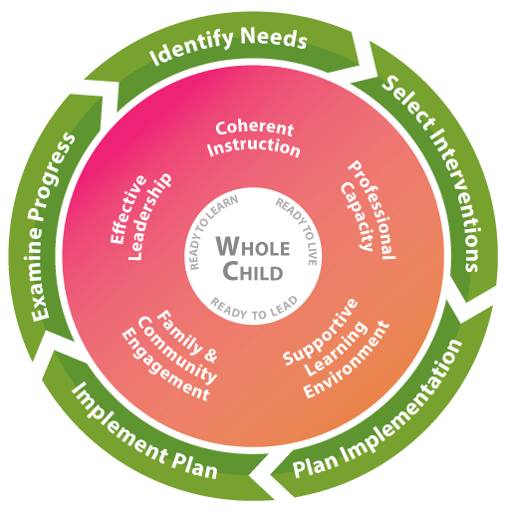
What Can Educators Do?
• Communicate, communicate, communicate
• Build trust
• Listen
• Eliminate jargon
• Structure IEP Team meetings
• Understand perspectives
• Reduce power imbalance
• Support family engagement
A major system of the complex school organization that develops quality links between local school professionals and the parents and community the school is intended to serve

Slide 5
What Can Parents Do?
Listen. Ask questions. Clarify.
Be clear about their goals.
Focus on the positives.
Keep the focus on meeting their child’s needs
Present options in a collaborative way (“we can” instead of “you should”)
Be mindful of their emotional pressure gauge as they work with their child’s school
From Steps to Success: Communicating with Your Child’s School from CADRE

Slide 6
A Continuum
Tension
Conflict
Dispute

Slide 7
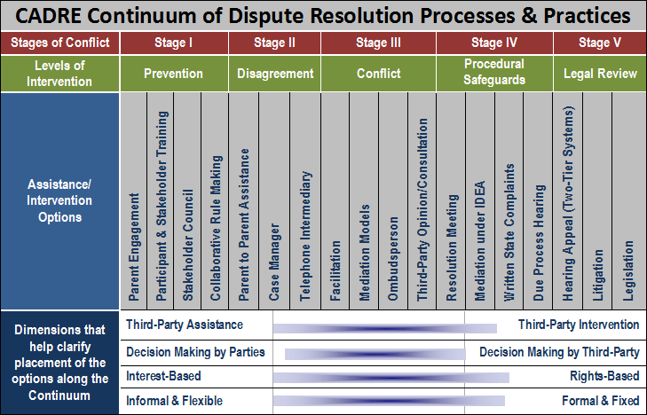



Slide 8
Dispute Resolution Process
Goal: Provide resolutions in disputes between parents and districts over the rights and services afforded to students with disabilities and their families
First Recommendation: Utilize techniques and strategies at the school level to possibly prevent disputes
Second Recommendation: Contact a special education administrator in the district to assist in working out the differences
Final Recommendation: When a resolution cannot be worked out locally, utilize the GaDOE’s and IDEA’s dispute prevention and resolution processes
.

Slide 9
Dispute Prevention Processes

Slide 10
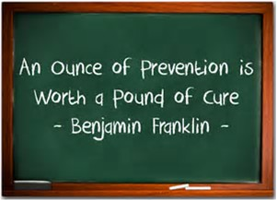

Slide 11

Special Education Support Desk
What is it?
  A telephone and email information and support line designed to answer special education-related questions and provide individuals with useful information and resources
Who can use it?
  Anyone, including parents, teachers, and school district administrators
Who is providing the information and support?
  Members of the GaDOE’s Dispute Resolution Unit

Slide 12
Special Education Support Desk
What type of information is provided?
  Explanation of IDEA procedural safeguards (Parent Rights)
  Information about, access to, and assistance with the dispute prevention and resolution processes
  Discussion of options for addressing concerns or disagreements about a student’s special education program
  Information relevant to the education of students with disabilities
  Information about other agency resources and materials

Slide 13

IEP Facilitation
What is it?
  A voluntary, collaborative dispute prevention and resolution process used when members of an IEP Team agree that the presence of a neutral third party would help facilitate communication and problem solving
  It is the same as any other IEP Team meeting, except that a neutral facilitator joins the meeting
Who can request it?
  Parents or schools districts in the following 20 counties/districts: Bartow, Bryan, Butts, Catoosa, Clayton, DeKalb, Evans, Fulton, Gainesville City, Greene, Ivy Preparatory Academies, Jackson, Lowndes, Pierce, Rome City, State Schools, Turner, Union, and White

Slide 14
IEP Facilitation
Why would someone request it?
  To help the IEP Team overcome any pressure or anxiety associated with complex or controversial meetings
  To assist an IEP Team who has had a history of difficult interactions
What will the facilitator do?
  Guide the discussions by asking student-focused questions
  Assist IEP Team members in the thoughtful, productive construction of a quality IEP
  Help create an agenda, group norms, and expected outcomes for the meeting
  Encourage full participation of all members of the IEP Team

Slide 15
Dispute Resolution Processes

Slide 16
Legally-Mandated Dispute Resolution Processes under the IDEA
Mediation (34 C.F.R. § 300.506)
Formal Written Complaints (34 C.F.R. §§ 300.151-300.153)
Due Process Hearing Requests (34 C.F.R. §§ 300.507-300.518)
  Resolution Sessions (34 C.F.R. § 300.510)

Slide 17
Mediation
What is it?
  A voluntary process that brings parents and school districts together to resolve their disagreements through the use of a skilled, impartial mediator
Who can request it?
  Parents or school districts
What is the time limit for requesting?
  None specified

Slide 18
Mediation
What issues can be resolved?
  Any matter under IDEA and the state special education rules
Who resolves the issues?
  Parents and school districts with assistance of a mediator
How are the issues resolved?
  Through a legally binding, written mediation agreement signed by both parties

Slide 19
Formal Complaints
What is it?
  A written complaint to the GaDOE alleging violations by the district that need to be investigated
Who can initiate it?
  Any person or organization
What is the time limit for filing?
  One year from the date of the alleged violation

Slide 20
Formal Complaints
What issues can be resolved?
  Alleged violations of IDEA and state special education rules
Who resolves the issues?
  GaDOE Division for Special Education Services and Supports
How are the issues resolved?
  Contracted investigator conducts investigation and interviews all relevant parties
  The GaDOE issues a written decision containing findings of facts and conclusions within 60 days of filing unless extended for exceptional circumstances
  If a finding of non-compliance is made, then appropriate corrective action is required

Slide 21

Due Process Hearing Request
What is it?
  A written document used to request a formal hearing before an administrative law judge (ALJ)
Who can initiate it?
  Parents or school districts
What is the time limit?
  Two years from when the parties knew or should have known of the alleged problem

Slide 22
Due Process Hearing Request
What issues can be resolved?
  Any matter related to the identification, evaluation, or educational placement, or provision of a free appropriate public education (FAPE) to the child
Who resolves the issues?
  An administrative law judge (ALJ)
How are the issues resolved?
  After the ALJ considers pleadings and evidence (including witness testimony) in a formal, judicial hearing, he/she issues a written decision within 45 days after the 30-day resolution period (unless extension granted)

Slide 23

Resolution Session
What is it?
  A meeting held between a parent and district to resolve issues listed in a due process hearing request
Who can initiate it?
  District must hold the meeting with the parent unless both parties agree in writing not to have the meeting or to use mediation instead
What is the time limit?
  Must occur within 15 days of the district receiving notice of the parent’s due process hearing request

Slide 24
Resolution Session
What issues can be resolved?
  The issues listed in the due process hearing request
Who resolves the issues?
  The parent and school district
How are the issues resolved?
  Through a written resolution agreement signed by both parties
  Legally binding after 3 business days

Slide 25
Now that you know the dispute prevention and dispute resolution processes, where can you direct parents to find more information regarding those processes?

Slide 26
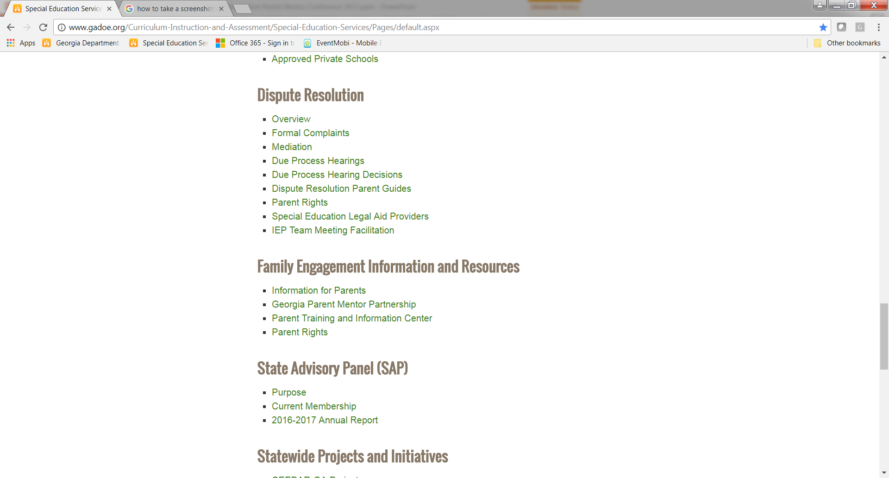
GaDOE Dispute Resolution Resources
http://www.gadoe.org/Curriculum-Instruction-and-Assessment/Special-Education-Services/Pages/default.aspx
Special Education Questions & Support
(404) 657-9968
SPEDHelpDesk@doe.k12.ga.us

Slide 27
What is available on the GaDOE website?
Overview Link
  Dispute Resolution Comparison Chart
Formal Complaints, Mediation, and Due Process Hearing Links
  Forms and FAQs
Due Process Hearing Decisions (FY 2001-2015)
Dispute Resolution Parent Guides (IEP Facilitation, Mediation, Written State Complaints, Due Process Complaints/Hearings, Resolution Meetings)
  English and Spanish
  Comparison Guide coming soon!

Slide 28
What is available on the GaDOE website?
Parent Rights Link
  Parent Rights Videos (7)
    English and Spanish
    Parent Notice/Consent/Confidentiality
    Evaluations and IEEs
    LRE
    Private School Placement
    Discipline Procedures/Rights
    Dispute Resolution
    Surrogate Parent/Transfer of Rights
  Condensed Parent Rights
  Full Parent Rights
    Arabic, Braille (UEB digital *brf), Chinese, English, Japanese, Korean, Spanish, Vietnamese
  Special Education Parent Supports and Legal Aid Providers
  IEP Team Meeting Facilitation

Slide 29
What is available on the GaDOE website?
  Parent Info Fact Sheets (18)
    Assistive Technology
    Discipline
    Due Process
    Extended School Year Services
    Evaluations
    Formal Complaints
    FBAs and BIPs
    GAA
    Helping your child with disabilities with homework
    IEP
    Mediation
    Person-Centered Planning
    Preparing your child with disabilities for kindergarten
    Reevaluations and IEEs
    Transition from Early Intervention to Public School
    Transition to Life after High School
    Understanding state and local testing
    Understanding statewide testing accommodations
Notes:
Includes “Facts you should know”, “Tips for Families”, and “Where to go for more information.”

Slide 30

Now that you know the dispute prevention and resolution processes, and where the information regarding those processes is located, how do you guide parents toward the most appropriate dispute prevention or resolution process?

Slide 31
Special Education Support Desk
Benefits | Considerations
Easy way to ask special education related questions | May not be able to provide in-depth answers
Can refer parties to appropriate personnel and resources as needed | No legal advice provided
Saves time for all involved | May be seen as impersonal
Can help resolve issues more quickly and easily (e.g. contacting SPED director) | May not completely resolve an issue
Information from GaDOE personnel
No cost

Slide 32
IEP Facilitation
Benefits | Considerations
May build and improve relationships among IEP Team members | Voluntary
Team members may feel better heard when a facilitator is involved | Not available in all school districts
Can help resolve disagreements more quickly | Facilitator will not address issues unrelated to the IEP
Keeps decision-making with the Team members who know the child best | Facilitator will not make decisions or determine if Team members are right or wrong
Neutral, third party facilitator | Facilitator is neutral and not an advocate
Scheduled just like any IEP Team meeting
No cost

Slide 33
Mediation
Benefits | Considerations
Mutually Developed and Agreed Upon Solution | Voluntary
Solution in short period of time | Less likely to reach resolution if not used early on
Flexibility in Solution | Can be emotional, tiring, and frustrating process
No cost | Complex situations may require more than one mediation session
Less Adversarial | No guarantees that mediation will lead to a written agreement
Confidential | Meet face-to-face
Legally binding and enforceable
Helps everyone better understand differing points of view

Slide 34
Formal Complaints
Benefits | Considerations
External investigation | Takes 60 days for resolution
No cost; mediation also available | Cannot overturn an IEP Team decision
Mainly a procedural rather than substantive review | Mainly a procedural rather than substantive review
Requires no legal representation; easy to file | Remedies not as extensive as judicial remedies and limited by law
No face-to-face adversariness | No mutually developed or agreed upon resolution
Can result in remedies (e.g. compensatory education, declarative/injunctive relief) | Investigation limited to issues within 1 year of filing
Can result in district-wide change and awareness | Final decision issued and no appeal process

Slide 35
Due Process Hearing Request
Benefits | Considerations
Stay put mechanism | Adversarial/Meet face to face in hearing
Broad range of relief allowed (“grant appropriate relief”) | Costly in time, emotion, and money; district will have attorney representation
More extensive relief (e.g. compensatory education, tuition reimbursement after unilateral placement) | Mainly a substantive rather than procedural review
If successful, can petition for attorney’s fees | Can place strain on relationships
Can look back 2 years or more in certain cases | Limited type of issues that can be raised
Required resolution session meeting unless both parties waive | Judge who does not know the child is making the decision (no mutually developed or agreed upon resolution)
Appealable decision | May take up to 75 days for a resolution (30 day resolution period plus 45 days for hearing/decision)

Slide 36
Resolution Session
Benefits | Considerations
Required resolution session meeting unless both parties waive | Discussions are not confidential
Mutually Developed and Agreed Upon Solution | No guarantees that resolution session will lead to a written agreement
Solution in short period of time; may prevent having to go to a hearing | Either party may cancel the agreement within 3 days
No cost | Usually limited to issues raised in the due process hearing request
District can only bring attorney if parent chooses to bring an attorney | Meet face-to-face
Helps everyone better understand differing points of view
Legally binding and enforceable

Slide 37
Who am I?
If you use me, I can look back at certain issues that occurred at least 2 years ago.
  Due process hearing request
I allow the GaDOE to make the final decision regarding whether the district was out of compliance with the IDEA.
  Formal Complaint

Slide 38
Who am I?
I am voluntary and use a third party to help parties reach a binding, legal agreement.
  Mediation
I allow the parties to resolve their issues and reach a legal agreement, but it is only binding after 3 days.
  Resolution Session

Slide 39
Who am I?
I am an easy way to ask a GaDOE employee questions related to special education?
  Special Education Support Desk
I help facilitate communication and problem solving at IEP Team meetings through a neutral third party?
  IEP Facilitation

Slide 40

Who am I?
Both of us result in an outside party making the final decision; one decides in 60 days and the other in 45-75 days, sometimes longer.
  Formal Complaint and Due Process Hearing Request
I am the only resolution process that can be initiated by individuals/organizations other than parents or districts.
  Formal Complaint

Slide 41
Scenario #1
Student not receiving 1 hour per week of counseling services
Teachers not implementing student’s BIP
Student received multiple detentions, ISS, and OSS
Parental concerns not being addressed after repeated contacts with case manager, lead teacher, and administrators

Slide 42
Scenario #2
8-year student with ASD
Parents and district cannot reach agreement on placement for next school year
Student has received all special education and related services at home
Parents want to continue 1-on-1 program at home and not “experiment” by putting student in regular school setting
District believes student is ready to be in school with peers and concerned about LRE

Slide 43
Scenario #3
4th grade student with mild cerebral palsy and developmental delays
Receives instruction in small group setting
Parent believes student will learn best when educated with non-disabled peers and wants student in general education classes
District believes the current placement is appropriate based on severity of student’s disability and need for individual attention and instruction

Slide 44
Scenario #4
5th grader found ineligible for special education for last 2 years
Parents feel strongly that student should be eligible and that eligibility is the only thing that will ensure that the school will be responsible for meeting the student’s needs
School psychologist said student’s academic performance is within normal limits for her age and grade; district maintains student does not need special education services

Slide 45
Can you hit the “bullseye”?
Can you compare and contrast the two dispute prevention processes and the three legally-mandated dispute resolution processes?
Can you direct parents on how to obtain information regarding the dispute resolution processes?
Can you help guide parents toward the specific dispute prevention or resolution process(es) that would be most appropriate for their circumstance?

Slide 46
Any Questions???
Jamila C. Pollard, Esq.
jpollard@doe.k12.ga.us
(404) 657-7329

