Slide 1
Dropout Prevention: Where Are We? What Have We Learned? What Works? (and What Does It Have to Do With Family Engagement?)
Sandy Addis
National Dropout Prevention Center
Clemson University
www.dropoutprevention.org

Slide 2
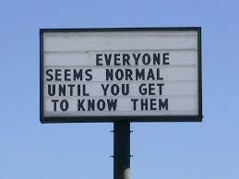
3 truths and a not so true

Slide 3
Sandy
Has one daughter who is a district attorney
Once worked as an insurance salesman
Taught over 100 children to water ski
Ran the New York Marathon

Slide 4
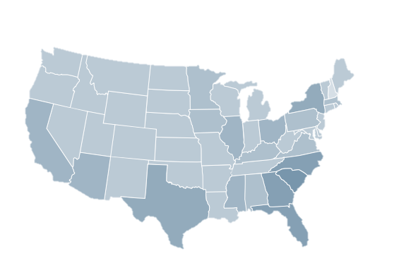
National Dropout Prevention Center
National Organization Located at Clemson University
Research
Resources
Professional Development
30th Years of Dropout Prevention
The Nation’s Most Utilized
Dropout Prevention Resource

Slide 5
U.S. Graduation Rates
83%
Public high school Averaged Freshman Graduation Rate (AFGR) data from http://nces.ed.gov/programs/coe/indicator_coi.asp
Public 4-Year Adjusted Cohort Graduation Rate (ACGR) data from https://nces.ed.gov/ccd/tables/ACGR_2010-11_to_2012-13.asp
Notes:
School reform should more appropriately be about education reform. It is not the school per se that needs to make the changes. Rather, it is the system of education that needs to make the changes.
The student needs to be at the center of this effort; a student centered system is needed.
The family needs to be the second most important consideration in terms of reform efforts.
And, the community needs to be the third most important consideration in terms of reform.
Up to recently most of our reforms have been internal to the school and these have the least amount of impact on student achievement and success.

Slide 6
Types of Dropout and Graduation Rates
According to NCES, its indicators of school dropout and school completion include the following:
Event dropout rate
Status dropout rate
Status completion rate
Averaged freshman graduation rate
(Non-regulatory cohort rate)
(National Center for Education Statistics, 2010. Trends in High School Dropout and Completion Rates in the United States: 1972-2008)
Notes:
Mention also the new federal regulatory graduation rate: The Adjusted Cohort Graduation Rate (only have about 3 years of data using that rate, so for trend analysis, we use Average Freshman Graduation Rate (AFGR) – a simple calculation based on enrollments and numbers of diplomas awarded so many years later.

Slide 7
Regulatory Four-Year Adjusted Cohort Graduation Rate

Slide 8
2016 4-Year Graduation Rates
State | 4-Year Rate
Alabama | 85%
Florida | 81%
Georgia | 79%
Mississippi | 82%
North Carolina | 86%
South Carolina | 83%
Tennessee | 88%

Slide 9
High School Graduation Rates—Nationwide
Butrymowicz, S. (July 2, 2015). ”The Graduation Rates From Every School District in One Map.” The Hechinger Report. http://hechingerreport.org/the-gradation-rates-from-every-school-district-in-one-map/ (Data from State Departments of Education.
Notes:
Data gathered from state departments of education. Missing some districts. The data don’t capture charter schools or private schools. Different states have different graduation requirements. And some reported rates may be questionable (according to the author of this report).

Slide 10
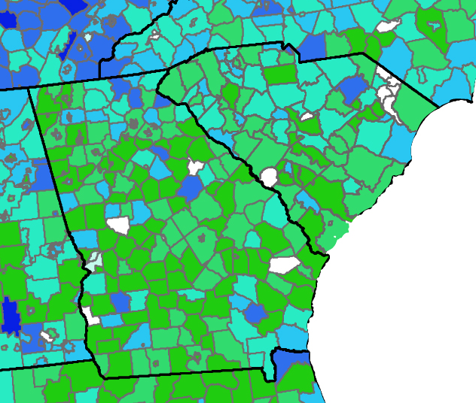
High School Graduation Rates—GA & SC
Butrymowicz, S. (July 2, 2015). ”The Graduation Rates From Every School District in One Map.” The Hechinger Report. http://hechingerreport.org/the-gradation-rates-from-every-school-district-in-one-map/ (Data from State Departments of Education.

Slide 11
Georgia 4-Year Graduation Rate Trends
2011 | 2012 | 2013 | 2014 | 2015 | 3016
67.4% | 69.7% | 71.8% | 72.5% | 78.8% | 79.2%
Governing Magazine, 2016
High School Graduation Rates by State

Slide 12
Georgia Class of 2014 4-Year Completion Rate
Group | Graduation Rate
All Students | 72.5%
S W D | 37%
L E P | 44%
E D | 63%
Am. Indian | 67%
Asian | 83%
Latino | 64%
Black | 65%
White | 80%

Slide 13
Research

Slide 14
Effect Sizes on Dropout
Academic Support
Behavioral Interventions
Career Development / Job Training
Family Engagement
Health & Wellness
Literacy Development
Mentoring
School / Classroom Environment
Service Learning
Work Based Learning

Slide 15
Effect Sizes on Dropout Rate (2015 Meta-Regression Analysis)
Chappell, S. L., O’Connor, P., Withington, C., & Stegelin, D. A. (2015, April). A meta-analysis of dropout prevention outcomes and strategies. Retrieved from www.dropoutprevention.org/ major-research-reports/meta-analysis
Notes:
All but two have statistically significant and substantial effects on dropout rates. (Those two may just need better measurements or more study)
The main point is that these are strategies that work. The report concludes that:
We hope our findings here will provide a mechanism by which decision makers can weigh the effectiveness and feasibility of particular strategies so they choose the strategies that will give them the most bang-for-the-buck for their education environments. As we finalize this study and extend our research efforts in this area, we believe we are on the verge of having evidence that can be directly applied to practical, real-time decisions made by local school officials. But we also should be able to extend our findings to legislators, policymakers, and program developers at state and national levels to help develop evidence-based solutions to the dropout problem.

Slide 16
The Problem ……………
Economic
Social
Quality of Life

Slide 17
Focus: Preventing Dropouts

Slide 18
Economics of High School Dropouts
Earn less
Pay less in taxes
Rely more on public health
More involved in criminal justice system
More likely to use welfare services
Have shorter life expectancy
(Rotermund, California Dropout Research Project, Statistical Brief 5, September 2007)

Slide 19
Unemployment Rate by Educational Attainment 2012
Doctoral degree...................... 2.5%
Professional degree............... 2.1%
Master’s degree..................... 3.5%
Bachelor’s degree.................. 4.5%
Associate’s degree................. 6.2%
Some college ......................... 7.7%
High school degree................. 8.3%
Less than high school............ 12.4%
(Bureau of Labor Statistics, May 2013, http://www.bls.gov/emp/ep_chart_001.htm)

Slide 20
The High Cost of Dropout - Medical
College graduates have better health, and lower medical costs, than high school graduates, while high school graduates have better health, and lower medical costs, than high school dropouts.
Cutting the number of high school dropouts in half nationally would save $7.3 billion in annual Medicaid spending – looking at overall spending and particularly spending on four key afflictions:
Alcoholism
Heart Disease
Obesity
Smoking
July 2013 Alliance for Excellent Education
On average, a high school graduate lives six to nine years longer than a high
school dropout.
Notes:
Medicaid savings statistics from:
Well and Well-Off: Decreasing Medicaid and Health-Care Costs by Increasing Educational Attainment Report July 10, 2013. Alliance for Excellent Education. http://www.all4ed.org/files/Well&WellOff.pdf
Data in callouts are from other sources cited in the above mentioned report.

Slide 21
Which of these students will drop out?

Slide 22
Has not passed math for 2 consecutive years
New to community. Family has moved three times this school year
Absent from school
22 days last school
year
Averages 15 office referrals/year for disruptive behavior

Slide 23
Four Domains – Risk Factors
Individual (6)
Family (5)
Community (3)
School (7)
High-risk demographic characteristics
Early adult responsibilities
High-risk attitudes, values, and behaviors
Poor school performance
Disengaged from school
Education stability
Background characteristics
Level of household stress
Family dynamics
Attitudes, values, and beliefs about education
Behavior related to education
Location and type of community
Demographic characteristics of community
Environment of community
School structure
School resources
Student body characteristics
Student body performance
School environment
Academic policies and procedures
Supervision and discipline policies/practices
24%
33%
Dropout Risk Factors and Exemplary Programs: A Technical Report, by C. Hammond, J. Smink, and S. Drew, NDPC and D. Linton, Communities In Schools, Inc. May 2007
Notes:
WE GET EGOCENTRIC – thinking everything kids are going through are a response to us

Slide 24
Dropout Pathway
Dropping out of school is the result of a long process of disengagement that may begin before a child enters school.

Slide 25
Grade Retention and School Dropout
Retention of one grade –
increases risk by 40%
Retention of two grades –
increases risk by 90%
(Roderick, M. PDK Research Bulletin, No. 15, 1995)

Slide 26
Understanding the Relationship Between
Grades and Graduation
% Graduated in Four Years
Average Freshman Grades
(The Consortium on Chicago School Research at the University of Chicago, 2007)

Slide 27
Relationship of Attendance to Graduation Rates
Days Absent in 8th Grade | Graduation Rate 5 Years Later
15+ days | 38%
11 – 14 days | 61%
6-10 days | 72%
1-5 days | 80%
0 days | 82%
Georgia Department of Education, 2016

Slide 28
What Students Say Top Five Reasons Reported by Students for Leaving School
1980
Didn’t like school (33%)
Poor grades (33%)
Chose to work (19%)
Getting married (18%)
Couldn’t get along with teachers (15%)

Slide 29
What Students Say Top Five Reasons Reported by Students for Leaving School
1980 | 1988
Didn’t like school (33%) | Didn’t like school (51%)
Poor grades (33%) | Were failing school (44%)
Chose to work (19%) | Couldn’t get along with teachers (34%)
Getting married (18%) | Couldn’t keep up with school work (31%)
Couldn’t get along with teachers (15%) | Feel like they don’t belong at school (25%)

Slide 30
What Students Say Top Five Reasons Reported by Students for Leaving School
1980 | 1988 | 2005
Didn’t like school (33%) | Didn’t like school (51%) | Classes were not interesting (47%)
Poor grades (33%) | Were failing school (44%) | Missed too many days and could not catch up (43%)
Chose to work (19%) | Couldn’t get along with teachers (34%) | Spent time with people not interested in school (42%)
Getting married (18%) | Couldn’t keep up with school work (31%) | Too much freedom and not enough rules in my life (38%)
Couldn’t get along with teachers (15%) | Feel like they don’t belong at school (25%) | Was failing in school (35%)

Slide 31
What Students Say Top Five Reasons Reported by Students for Leaving School
1980 | 1988 | 2005
Didn’t like school (33%) | Didn’t like school (51%) | Classes were not interesting (47%)
Poor grades (33%) | Were failing school (44%) | Missed too many days and could not catch up (43%)
Chose to work (19%) | Couldn’t get along with teachers (34%) | Spent time with people not interested in school (42%)
Getting married (18%) | Couldn’t keep up with school work (31%) | Too much freedom and not enough rules in my life (38%)
Couldn’t get along with teachers (15%) | Feel like they don’t belong at school (25%) | Was failing in school (35%)
*
*
*

Slide 32
We Know There Are 15 Effective Dropout Prevention Strategies
Safe Learning Environment
Family Engagement
Service Learning
Active Learning
Early Childhood Education
Professional Development
Mentoring/Tutoring
Systemic Approach
Educational Technology
Early Literacy Development
Alternative Schooling
After- & Out-of-School Instruction
Career & Technical Education
Individualized Instruction
School– Community
Collaboration

Slide 33
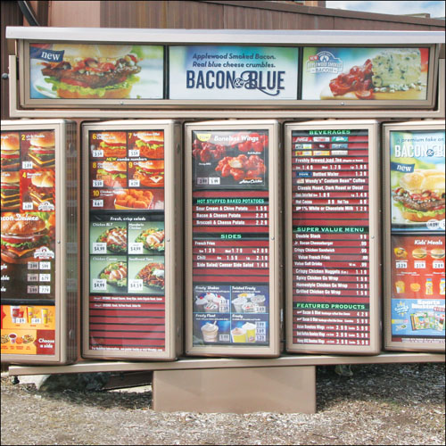
How Do We Select Strategies?

Slide 34
Strategies Must Be Strategically Selected & Applied
Individualized
Instruction
Educa tional Technology
Active
Learning
Career &
Technical
Education
Professional
Development
Mentoring/Tutoring
Service- Learning
Alternative
Schooling
After- & Out-of-School Instruction
Family Engagement
Early Childhood Education
Early Literacy Development
Systemic Approach
School– Community
Collaboration
Safe Learning Environment

Slide 35
Organizing the 15 Effective Strategies
Basic Foundational Strategies

Slide 36
Organizing the 15 Effective Strategies
Basic Foundational Strategies
Systemic Approach

Slide 37
Organizing the 15 Effective Strategies
Basic Foundational Strategies
Systemic Approach
School– Community
Collaboration

Slide 38
Organizing the 15 Effective Strategies
Basic Foundational Strategies
Systemic Approach
School– Community
Collaboration
Safe Learning Environment

Slide 39
Organizing the 15 Effective Strategies
Systemic Approach
School– Community
Collaboration
Safe Learning Environment

Slide 40
Organizing the 15 Effective Strategies
Early Interventions
Systemic Approach
School– Community
Collaboration
Safe Learning Environment

Slide 41
Organizing the 15 Effective Strategies
Early Interventions
Family Engagement
Systemic Approach
School– Community
Collaboration
Safe Learning Environment

Slide 42
Organizing the 15 Effective Strategies
Early Interventions
Family Engagement
Early Childhood Education
Systemic Approach
School– Community
Collaboration
Safe Learning Environment

Slide 43
Organizing the 15 Effective Strategies
Early Interventions
Family Engagement
Early Childhood Education
Early Literacy Development
Systemic Approach
School– Community
Collaboration
Safe Learning Environment

Slide 44
Organizing the 15 Effective Strategies
Family Engagement
Early Childhood Education
Early Literacy Development
Systemic Approach
School– Community
Collaboration
Safe Learning Environment

Slide 45
Organizing the 15 Effective Strategies
Basic Core Strategies
Family Engagement
Early Childhood Education
Early Literacy Development
Systemic Approach
School– Community
Collaboration
Safe Learning Environment

Slide 46
Organizing the 15 Effective Strategies
Basic Core Strategies
Mentoring/ Tutoring
Family Engagement
Early Childhood Education
Early Literacy Development
Systemic Approach
School– Community
Collaboration
Safe Learning Environment

Slide 47
Organizing the 15 Effective Strategies
Basic Core Strategies
Mentoring/Tutoring
Service- Learning
Family Engagement
Early Childhood Education
Early Literacy Development
Systemic Approach
School– Community
Collaboration
Safe Learning Environment

Slide 48
Organizing the 15 Effective Strategies
Basic Core Strategies
Mentoring/Tutoring
Service- Learning
Alternative Schooling
After- & Out-of-School Instruction
Family Engagement
Early Childhood Education
Early Literacy Development
Systemic Approach
School– Community
Collaboration
Safe Learning Environment

Slide 49
Organizing the 15 Effective Strategies
Managing and Improving Instruction
Mentoring/Tutoring
Service- Learning
Alternative Schooling
After- & Out-of-School Instruction
Family Engagement
Early Childhood Education
Early Literacy Development
Systemic Approach
School– Community
Collaboration
Safe Learning Environment

Slide 50
Organizing the 15 Effective Strategies
Managing and Improving Instruction
Individualized Instruction
Mentoring/Tutoring
Service- Learning
Alternative Schooling
After- & Out-of-School Instruction
Family Engagement
Early Childhood Education
Early Literacy Development
Systemic Approach
School– Community
Collaboration
Safe Learning Environment

Slide 51
Organizing the 15 Effective Strategies
Managing and Improving Instruction
Individualized Instruction
Educational Technology
Mentoring/Tutoring
Service- Learning
Alternative Schooling
After- & Out-of-School Instruction
Family Engagement
Early Childhood Education
Early Literacy Development
Systemic Approach
School– Community
Collaboration
Safe Learning Environment

Slide 52
Organizing the 15 Effective Strategies
Managing and Improving Instruction
Individualized Instruction
Educational Technology
Active Learning
Mentoring/Tutoring
Service- Learning
Alternative Schooling
After- & Out-of-School Instruction
Family Engagement
Early Childhood Education
Early Literacy Development
Systemic Approach
School– Community
Collaboration
Safe Learning Environment

Slide 53
Organizing the 15 Effective Strategies
Managing and Improving Instruction
Individualized Instruction
Educational Technology
Active Learning
Career & Technical Education
Professional Development
Mentoring/Tutoring
Service- Learning
Alternative Schooling
After- & Out-of-School Instruction
Family Engagement
Early Childhood Education
Early Literacy Development
Systemic Approach
School– Community
Collaboration
Safe Learning Environment

Slide 54
Strategies Must Be Strategically Selected & Applied
Individualized
Instruction
Educa tional Technology
Active
Learning
Career &
Technical
Education
Professional
Development
Mentoring/Tutoring
Service- Learning
Alternative
Schooling
After- & Out-of-School Instruction
Family Engagement
Early Childhood Education
Early Literacy Development
Systemic Approach
School– Community
Collaboration
Safe Learning Environment

Slide 55
Strategies Must Be Strategically Selected & Applied
Individualized
Instruction
Educa tional Technology
Active
Learning
Career &
Technical
Education
Professional
Development
Mentoring/Tutoring
Service- Learning
Alternative
Schooling
After- & Out-of-School Instruction
Family Engagement
Early Childhood Education
Early Literacy Development
Systemic Approach
School– Community
Collaboration
Safe Learning Environment

Slide 56
Strategies Must Be Strategically Selected & Applied
Individualized
Instruction
Educa tional Technology
Active
Learning
Career &
Technical
Education
Professional
Development
Mentoring/Tutoring
Service- Learning
Alternative
Schooling
After- & Out-of-School Instruction
Family Engagement
Early Childhood Education
Early Literacy Development
Systemic Approach
School– Community
Collaboration
Safe Learning Environment

Slide 57
Strategies Must Be Strategically Selected & Applied
Individualized
Instruction
Educa tional Technology
Active
Learning
Career &
Technical
Education
Professional
Development
Mentoring/Tutoring
Service- Learning
Alternative
Schooling
After- & Out-of-School Instruction
Family Engagement
Early Childhood Education
Early Literacy Development
Systemic Approach
School– Community
Collaboration
Safe Learning Environment

Slide 58
Strategies Must Be Strategically Selected & Applied
Individualized
Instruction
Educa tional Technology
Active Learn ing
Career &
Technical
Education
Professional
Development
Mentoring/Tutoring
Service- Learning
Alternative
Schooling
After- & Out-of-School Instruction
Family Engagement
Early Childhood Education
Early Literacy Development
Systemic Approach
School– Community
Collaboration
Safe Learning Environment

Slide 59
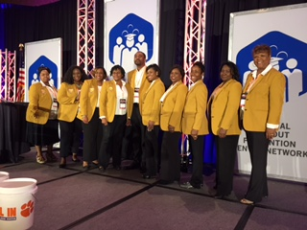

Slide 60
McLaren Success Academy
Fulton County, GA
2016
Graduation Rate
61 %
2012
Graduation Rate
19 %

Slide 62
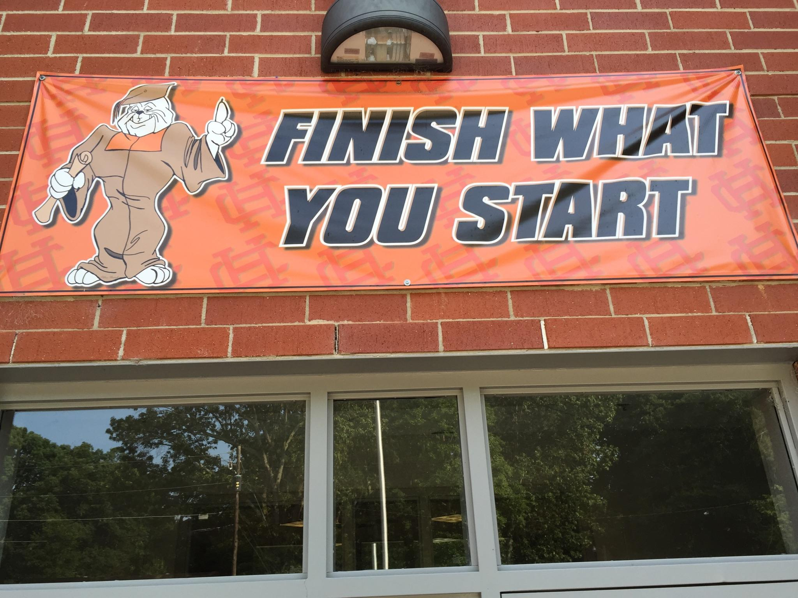

Slide 63
Hello, I'm Grad Dog, and I'm here to help all of our young Hart County Bulldogs to earn a high school diploma. Whether you are in Kindergarten or a Senior at HCHS, I am cheering you on with the Grad Dog Motto: Finish what you start! You can do it!

Slide 65
Atlanta Journal-Constitution
Georgia schools use competition to motivate students, community. Graduation Cup helps boost rates in Hart, Franklin counties
CARNESVILLE - It was a typical scene at the Oct. 12 football game between Franklin County and Hart County. Representatives from each school marched shoulder to shoulder onto the midfield, in the next chapter of the intense rivalry between the two high schools.
What was unusual: The scene was during half-time, and the school representatives on the field were not the football team captains. Instead, they were school superintendents, graduation coaches, mascots and students from each school………….

Slide 66
Hart County School System
African American Students
Hartwell, GA
2016
All Students Grad Rate = 92%
African American Grad Rate = 96%
2011
All Students Grad Rate = 77%
African American Grad Rate = 66%

Slide 67
Sandy Addis
haddis@clemson.edu
www.dropoutprevention.org
Google “dropout prevention”

