Slide 1
How to Build
A
CHAMPION!
Presented by the Savannah Chatham County Community

Slide 2
2016 GA PMP Kickoff Night of Champions Presentation
Allyson Harvin and Kevin Horton’s Presentation at our 2016 luncheon in Savannah
The Lowcountry Down Syndrome Society:
- is a family support group to benefit people with Down syndrome and their families
- through local leadership
- outreach
- education and advocacy
to champion and celebrate acceptance and inclusion!

Slide 3
Night of Champions
LDSS organizes Night of Champions — an annual community event recognizing area businesses that employ differently-abled adults, including those with Down syndrome, and celebrates the contributions made by these employees.

Slide 4
http://www.wtoc.com/Clip/13325807/good-news-ldss-night-of-champions#.WbvkYLQKVWI.email

Slide 5
How do we get students with special needs ready for employment?
How do we build Champions?
What is the path to be ready for employment after graduating?

Slide 6
CBI/CBVI
Start CBI in middle school at least twice monthly
Teach community access
Start CBVI in high school at least twice weekly
Teach work behavior
Job sampling
Teach public transit

Slide 7
Internships
Work independently with support from district job coach
Student may be on site up to one full school year
Student may ride public transit independently
Student may participate in in 2 or more internships
Students are typically on GAA or DOP

Slide 8
Project Search
Two locations in Savannah ( Armstrong State University & St Joseph’s/Candler Health Systems
Students participate in 3 job rotations during 1 year
Total work immersion, students must travel independently to and from work/home

Slide 9
https://youtu.be/cyMG6KmPnmA

Slide 10
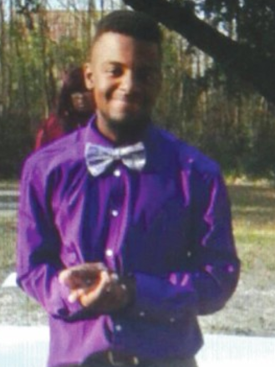
Meet Nick Brown and Mr. Brown

Slide 11
Ingredients of a CHAMPION...​
C apitalize on your local strengths and resources​
H old your stakeholders accountable​
A gency support​
M otivated team members​
P artnerships local businesses​
I nnovative ideas and practices​
O pportunities to educate the community​
N ew pathways to employment​
S elf-determination and self-advocacy encouraged​

Slide 12
Join us and see first hand the wonder and excitement
of the
2018 Night of Champions
10 May 2018

