Slide 1
988: Georgia’s Public Crisis Continuum
Georgia Department of Behavioral Health & Developmental Disabilities
Dawn Peel, LPC CPCS
Director, Office of Crisis Coordination
August 28, 2024

Slide 2
988 and DBHDD State Funded Crisis System

Slide 3
Right now, in Georgia, anyone experiencing a suicidal crisis or emotional distress should call or text 988 or access 988 chat services using this website: 988lifeline.org.
GCAL is available 24 hours a day, 7 days a week.
DRAFT
WHAT IS
9-8-8?
9-8-8 is a direct, national three-digit line that will connect individuals with suicide prevention and mental health crisis resources.
Since July 2022, 9-8-8 calls in Georgia have been answered by the Georgia Crisis and Access Line (GCAL), 24 hours a day, 7 days a week, 365 days a year.
Some of 9-8-8’s key features include:
Connect a person with immediate and ongoing resources
Promote cost efficiency
Reduce impact on safety resources
Help end stigma of seeking care
Notes:
Speaker: Debbie
A direct, national three-digit line, 9-8-8, will open the door for millions of Americans to seek the help they need, while sending the message to the country that healing, hope and help are happening every day. In Georgia, the 9-8-8 calls will be answered by the Georgia Crisis and Access Line (GCAL), 24 hours a day, 7 days a week, 365 days a year.
Some of 9-8-8’s key features include:
Connecting a person in a behavioral health crisis to someone who can address their immediate needs and help connect them to ongoing care
Promote cost efficiency by providing the most appropriate response
Reducing burden on law enforcement, public health and other safety resources when not appropriate
Helping end stigma of seeking or accessing behavioral healthcare

Slide 4
9-8-8 is an opportunity:
One of the largest federally mandated crisis response transformations in decades.
Designed to meet the rising needs
of mental health, substance abuse disorders and suicide interventions.

Slide 5
9-8-8 Suicide & Crisis Lifeline Overview
The 9-8-8 law requires Georgia to enhance the current system’s ability
to respond to those experiencing a behavioral health crisis by providing:
Someone to
talk to
Someone to respond
A safe place
for help
Available 24/7 for calls, text and chat
Peer-run warm lines offering callers emotional support, staffed by individuals who are in recovery themselves
Mobile crisis available statewide
Coordinate with 9-1-1/EMS as appropriate
Outpatient community provider response
Crisis stabilization units
Crisis service center
Peer wellness respite
Detox and Substance Use Disorder (SUD) treatment
Inpatient beds
Outpatient crisis
Notes:
When there is a mental health or substance use emergency, many do not know what to do. Call their primary care doctor? Call the police? Call 9-1-1? Go to the emergency room? These responses place an unnecessary burden on local law enforcement and emergency services and rarely provide the most effective result for the individual experiencing the behavioral health crisis.
In Georgia you can call/text or chat GCAL now, but starting on July 16, 2022, individuals will be able to dial 9-8-8 for suicide prevention and behavioral health crisis resources.
9-8-8 provides an easy-to-remember three-digit number to provide access to immediate behavioral health support.

Slide 6
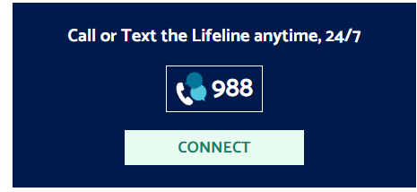
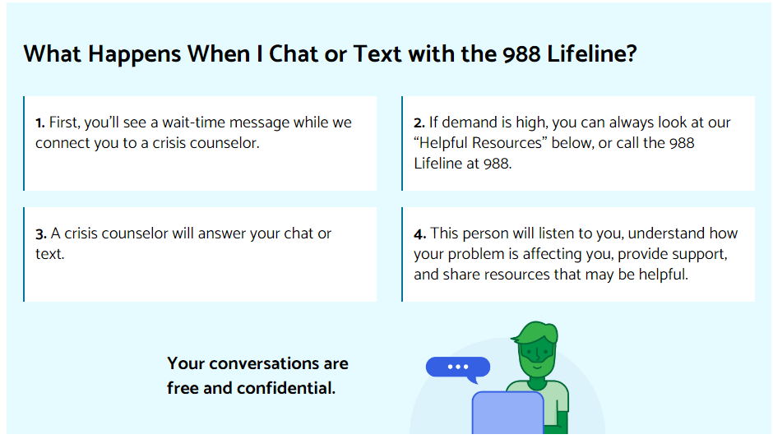
988 Lifeline Chat and Text - 988 Suicide & Crisis Lifeline
988 Lifeline Crisis Chat and Text is currently only available in English and Spanish. To connect with the 988 Lifeline in Spanish, text AYUDA to 988.
If you need support in a language other than English or Spanish, please call 988.
988 Lifeline Chat and Text - 988 Suicide & Crisis Lifeline

Slide 7
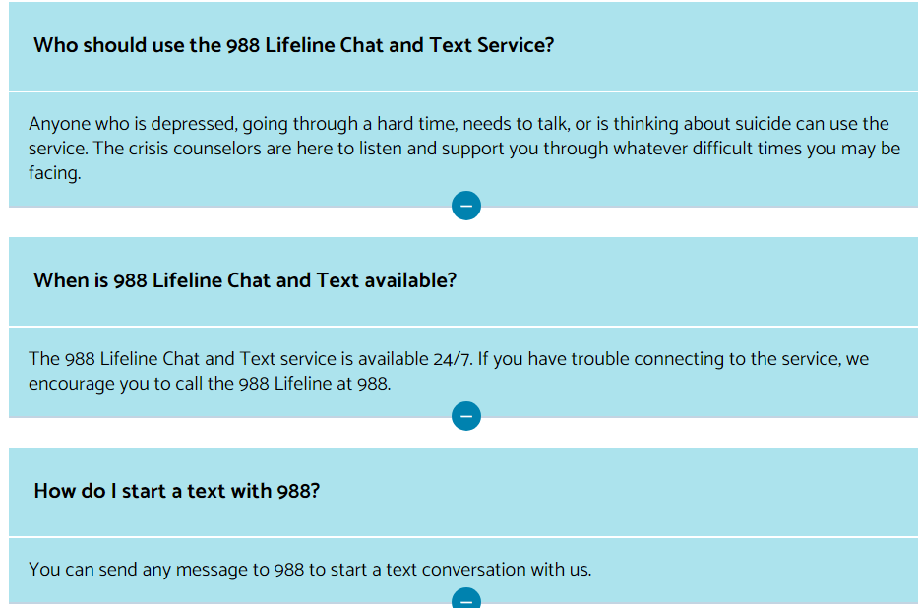
Text and Chat FAQs
988 Lifeline Chat and Text - 988 Suicide & Crisis Lifeline
Notes:
Be prepared to answer question about whether parents can access their youth’s messaging

Slide 8
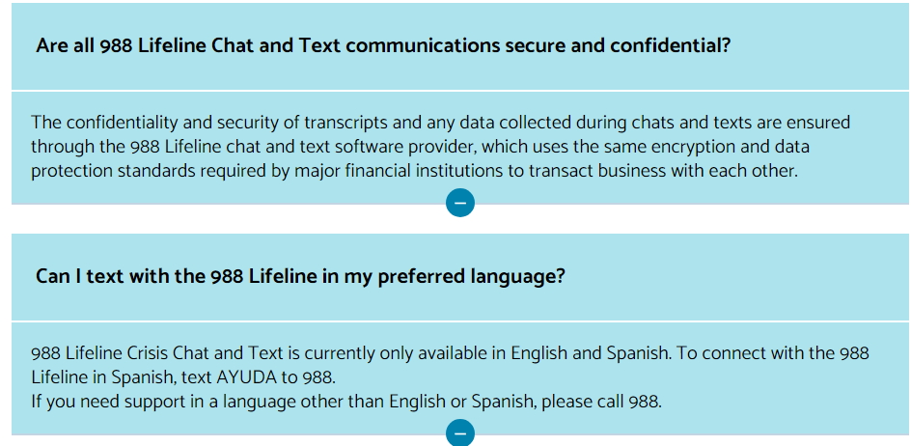
Text and Chat FAQs
988 Lifeline Chat and Text - 988 Suicide & Crisis Lifeline

Slide 9
9-8-8 Mobile Crisis Response - Animated Video — 988ga.org

Slide 10
988 and DBHDD Resources

Slide 11
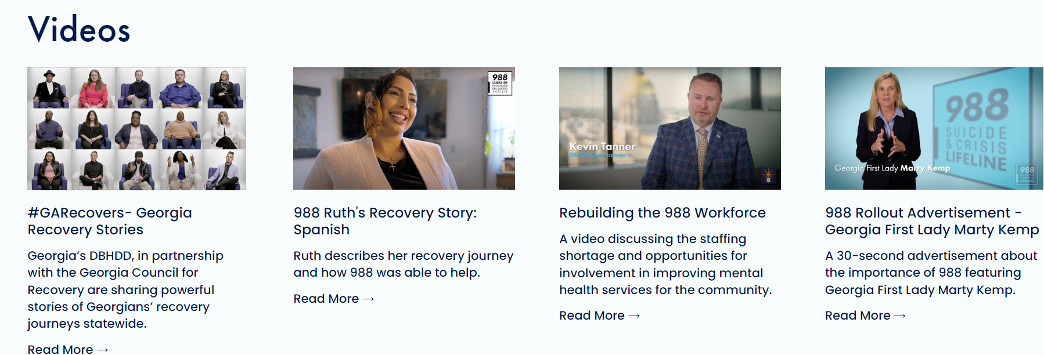
FAQs, One-Sheets, Logos, Recorded Webinars, Assets: 988ga.org
Contact Us: questions@988.org

Slide 12
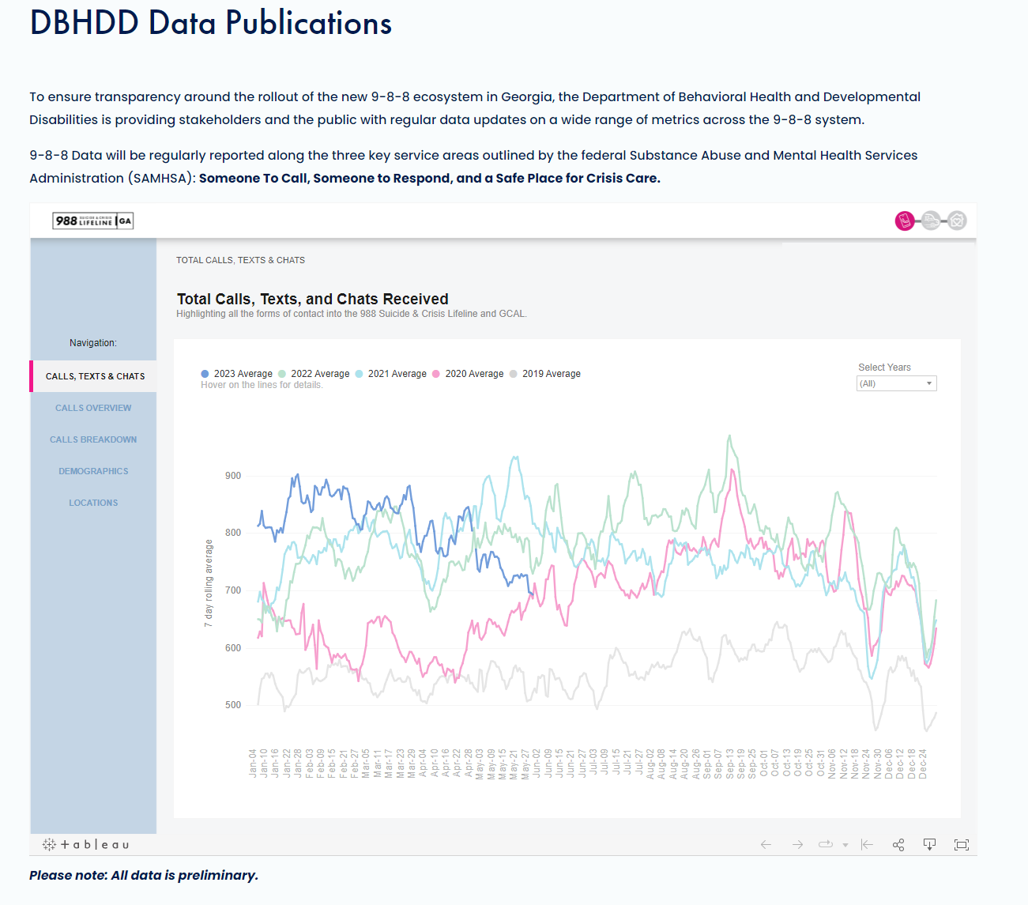
New Features on 988ga.org

Slide 13
Regional Resources
Outpatient and Crisis Services:
Community Service Board of Middle Georgia
Locations in Waynesboro, Swainsboro, Dublin
DBHDD Regional Field Office Resources:
Gwen Craddieth, Regional Coordinator
Gwen.Craddieth@dbhdd.ga.gov
April Edwards, Behavioral Health Regional Services Administrator
April.Edwards@dbhdd.ga.gov
Carol Love, Developmental Disability Regional Services Administrator
Carol.Love@dbhdd.ga.gov

Slide 14
Dawn Peel, LPC CPCS
Director, Office of Crisis Coordination
404-210-4161
Dawn.peel@dbhdd.ga.gov

