Slide 1
NOW/COMP Waivers:
What You NEED To Know

Slide 2
Objectives
Provide overview of NOW and COMP Waiver Services
1
Explore the myths about waiver services
2
Discover appropriate resources for unique questions
3

Slide 3
Waiver overview
Who?
What?
When?
Why?
How
Notes:
People living with an intellectual/developmental disability or closely related condition that impedes their ability to live and engage independently in their family home/community.

Slide 4
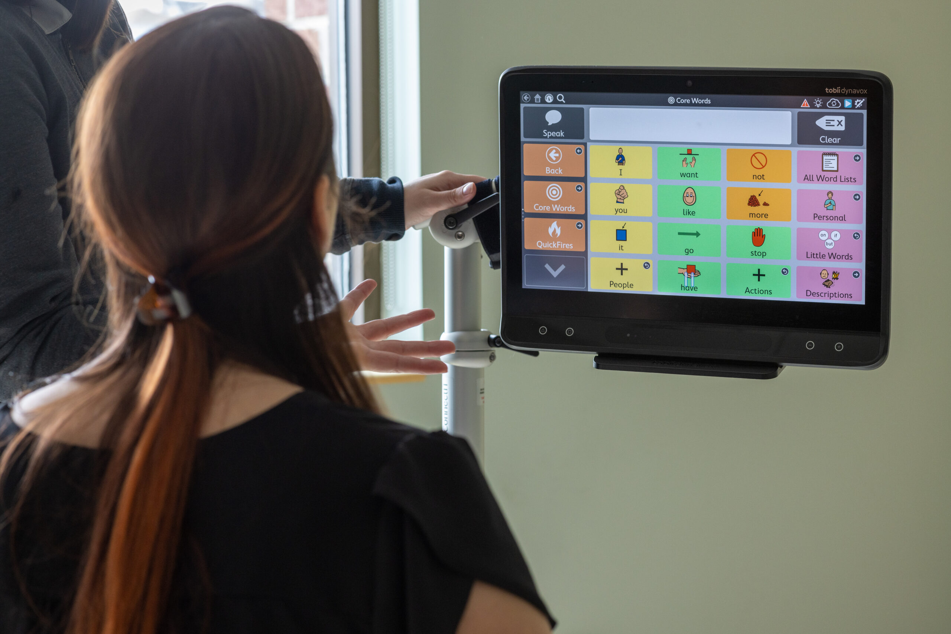
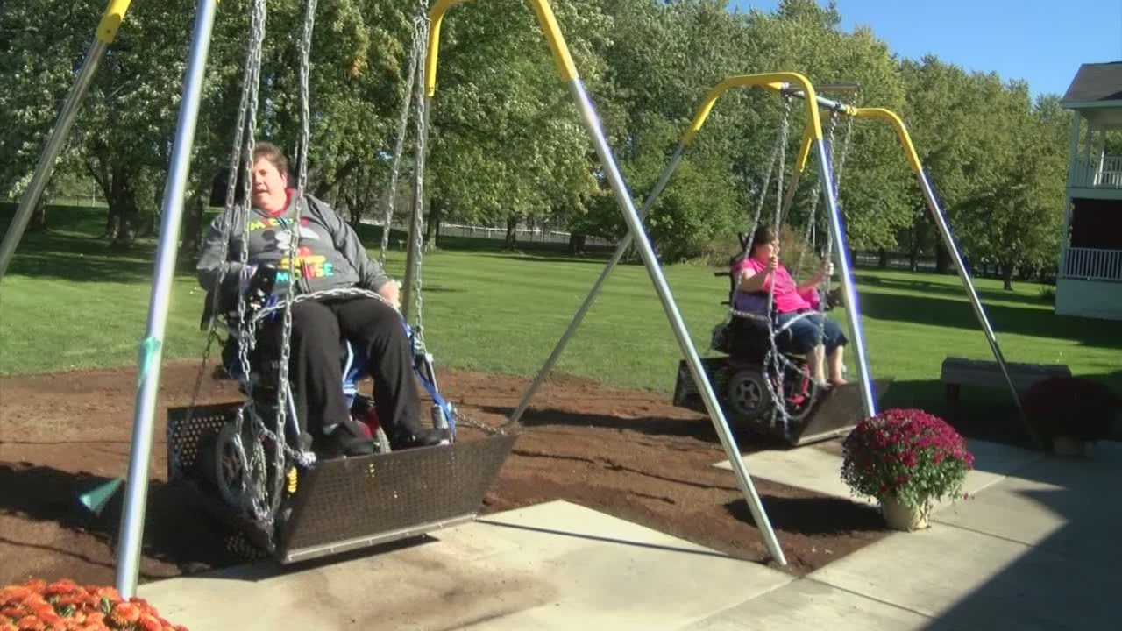
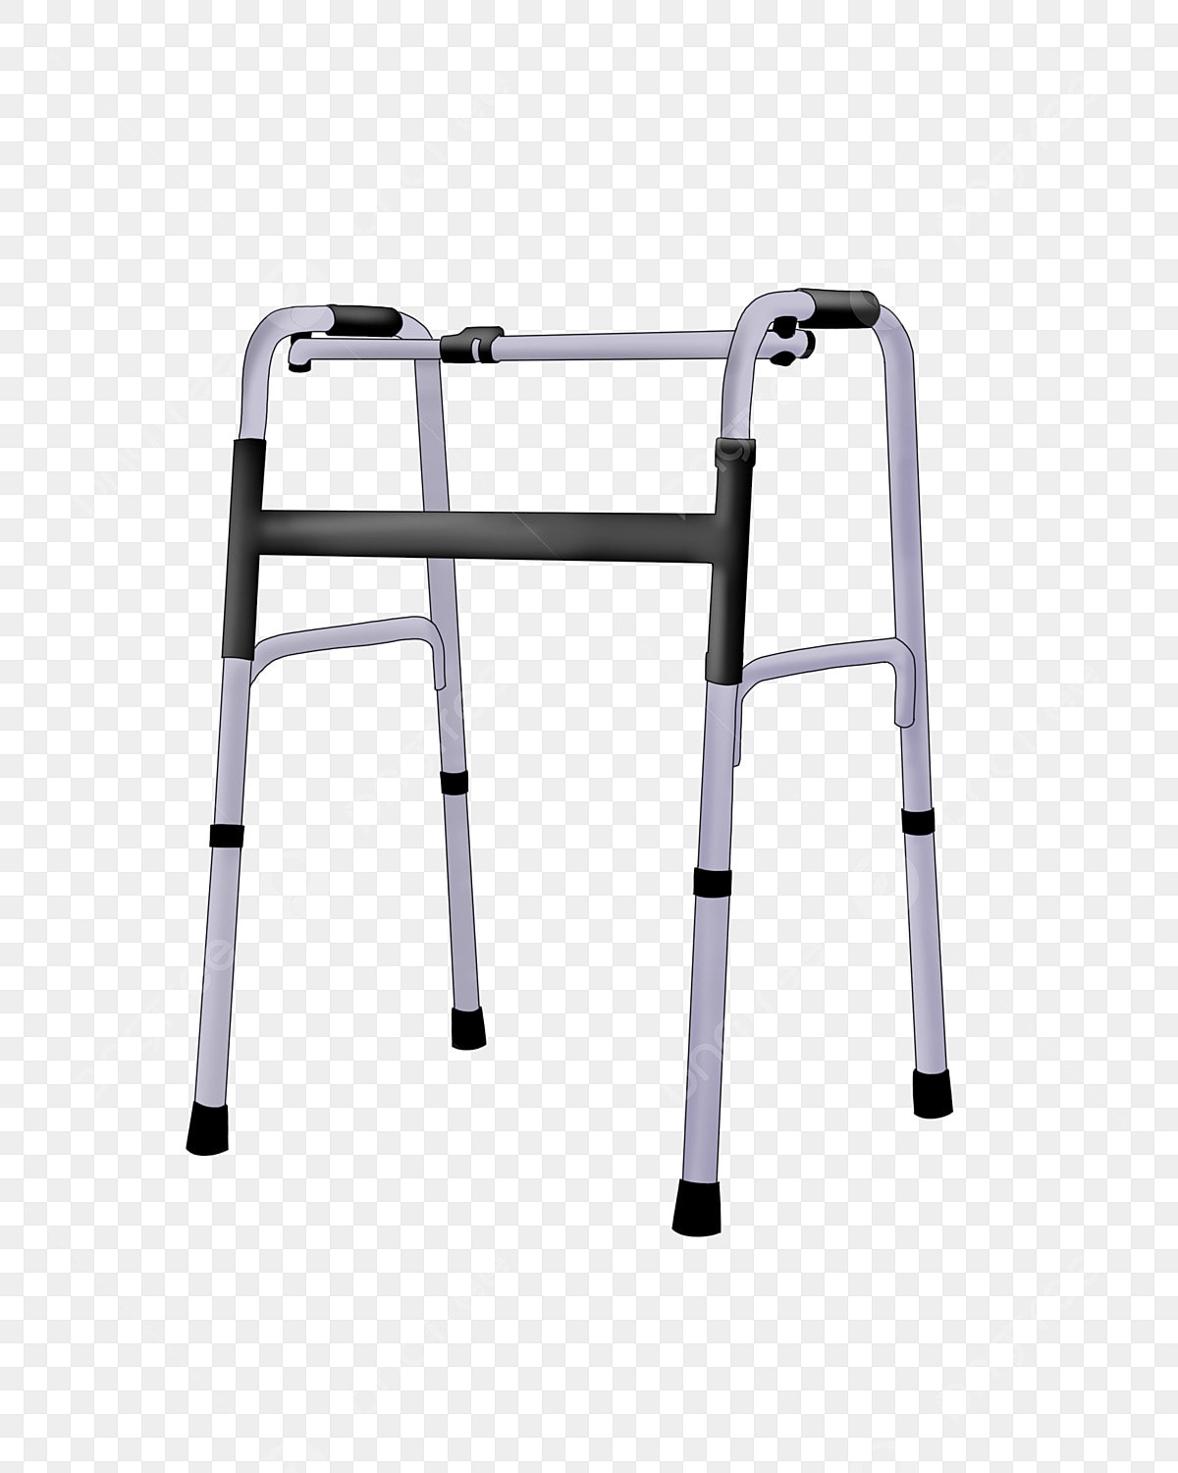
Services

Slide 5
Application
https://www.georgiacollaborative.com/individuals-families/iddconnects/
Official Birth Certificate
Medicaid/Medicare Card
Psychological Evaluation
Social Security Card
Developmental Evaluation
School IEP Report
School Transcript
Vocational/Support Employment Records
Permanent Residence Card
Social Security Benefit Letter
Other Medical or Diagnostic Reports

Slide 6
Eligibility Process
Individual
Program Assistant
Intake Coordinator
Psychologist
Intake Coordinator
Individual
Intake Coordinator
Psychologist
Cycle Repeats

Slide 7
Planning list
Pre-eligibility
DON-R Assessment
Annual Assessment
“Most in Need” determination

Slide 8
common myths
There are 7,000 Georgians in immediate need of services on the waiting list
You must wait at least 10 years to get a waiver
Everyone on the planning list is entitled to a waiver
Children are not eligible for a waiver
Waivers are “lifetime” funds

Slide 9
“Most in need”
Exhausted all other services and/or agencies that are responsible for providing support

Slide 10
assessments
Supports Intensity Scale (SIS)
Nursing
Health Risk Screening Tool (HRST)
Behavioral Support
Social Work

Slide 11
Enrollment process
Planning List Administrator Assignment
DMA 6
Individual Engagement
ROI
Medicaid/SSI Verification
Provider Search
Individualized Support Plan

Slide 12
Approval
Georgia medical care foundation (gmcf/alliant)

Slide 14
Resources
Manuals
https://www.mmis.georgia.gov/portal/PubAccess.Provider%20Information/Provider%20Manuals/tabId/18/Default.aspx

Slide 15
Tawanda Scales, LMFT
Aamft supervisor in training
Tawanda.scales1@dbhdd.ga.gov
(470) 487-6824

