Slide 1
Unlocking the Power of Early Literacy: A Guide for Parents
Parent Mentor Kickoff
September 12, 2024

Slide 2
Office of Federal Programs
The Georgia Department of Education, Office of Federal Programs provides technical assistance, program monitoring, and resources to local educational agencies (LEA) implementing federal Every Student Succeeds Act (ESSA) grants and Individuals with Disabilities Education Act (IDEA) grants. Additionally, this office provides the necessary infrastructure to support local school districts in their efforts to provide special education-related services for students with disabilities and services and supports for English learners.​​​

Slide 4
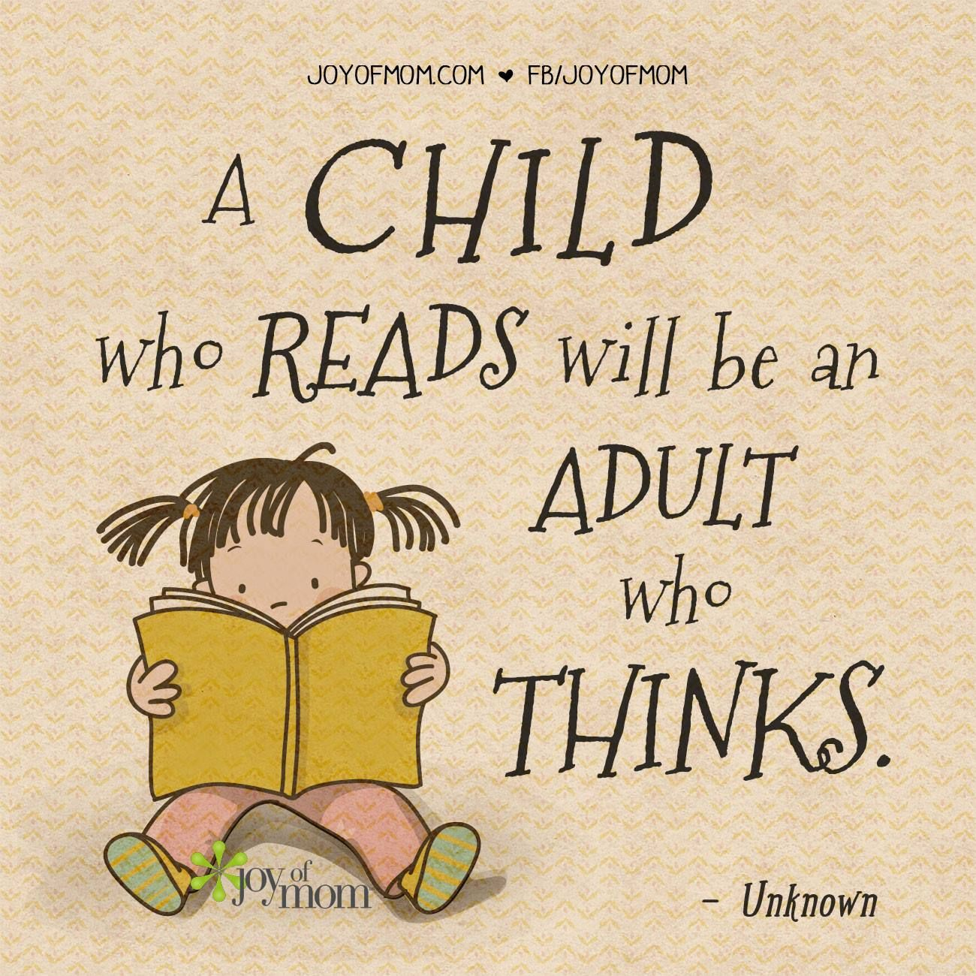
Raising Readers

Slide 5
Language and Literacy
Language is the system of patterns and symbols we use to communicate
May be spoken, written, or signed
Receptive – listening, reading, watching
Expressive – speaking, writing, signing
Literacy is the ability to read and write

Slide 6
The Spoken Language and Literacy Connection
Talking and listening during preschool prepare children to learn to read and write.
Children with weaker verbal abilities are more likely to experience difficulties with literacy skills.

Slide 7
Early Language and Emergent Literacy
When do children start to learn language?
Children learn language from the day they are born.
Are spoken language and literacy connected?
YES! As a child learns to speak and listen, they are building skills to prepare them to read and write.
What is emergent literacy?
Stage where children develop speech and language skills that are important to the development of literacy. It begins at birth and continues through preschool.

Slide 8
Emergent Literacy Skills
They begin to recognize words that rhyme.
They scribble with crayons.
They see and interact with print.
They point out street signs and logos (think Golden Arches).
They begin to name some letters of the alphabet.
They combine what they know about speaking and listening with what they know about print and become ready to learn to read and write!

Slide 9
Why is Emergent Literacy Important?

Slide 10
The Developing Brain!

Slide 11
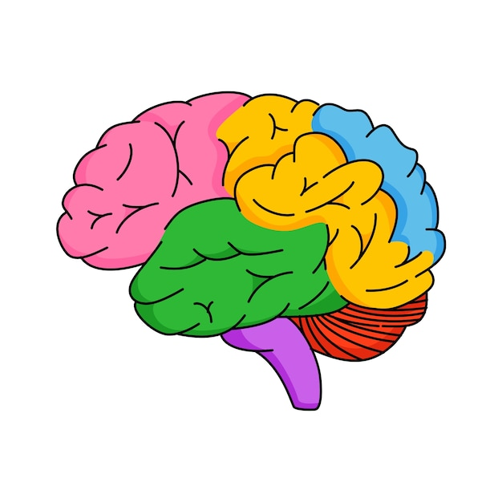
The Positive Impact of Early Intervention on the Brain
The brain is strengthened by positive early experiences, especially stable relationships with caring and responsive adults, safe and supportive environments, and appropriate nutrition.
Harvard University Center on the Developing Child​

Slide 12
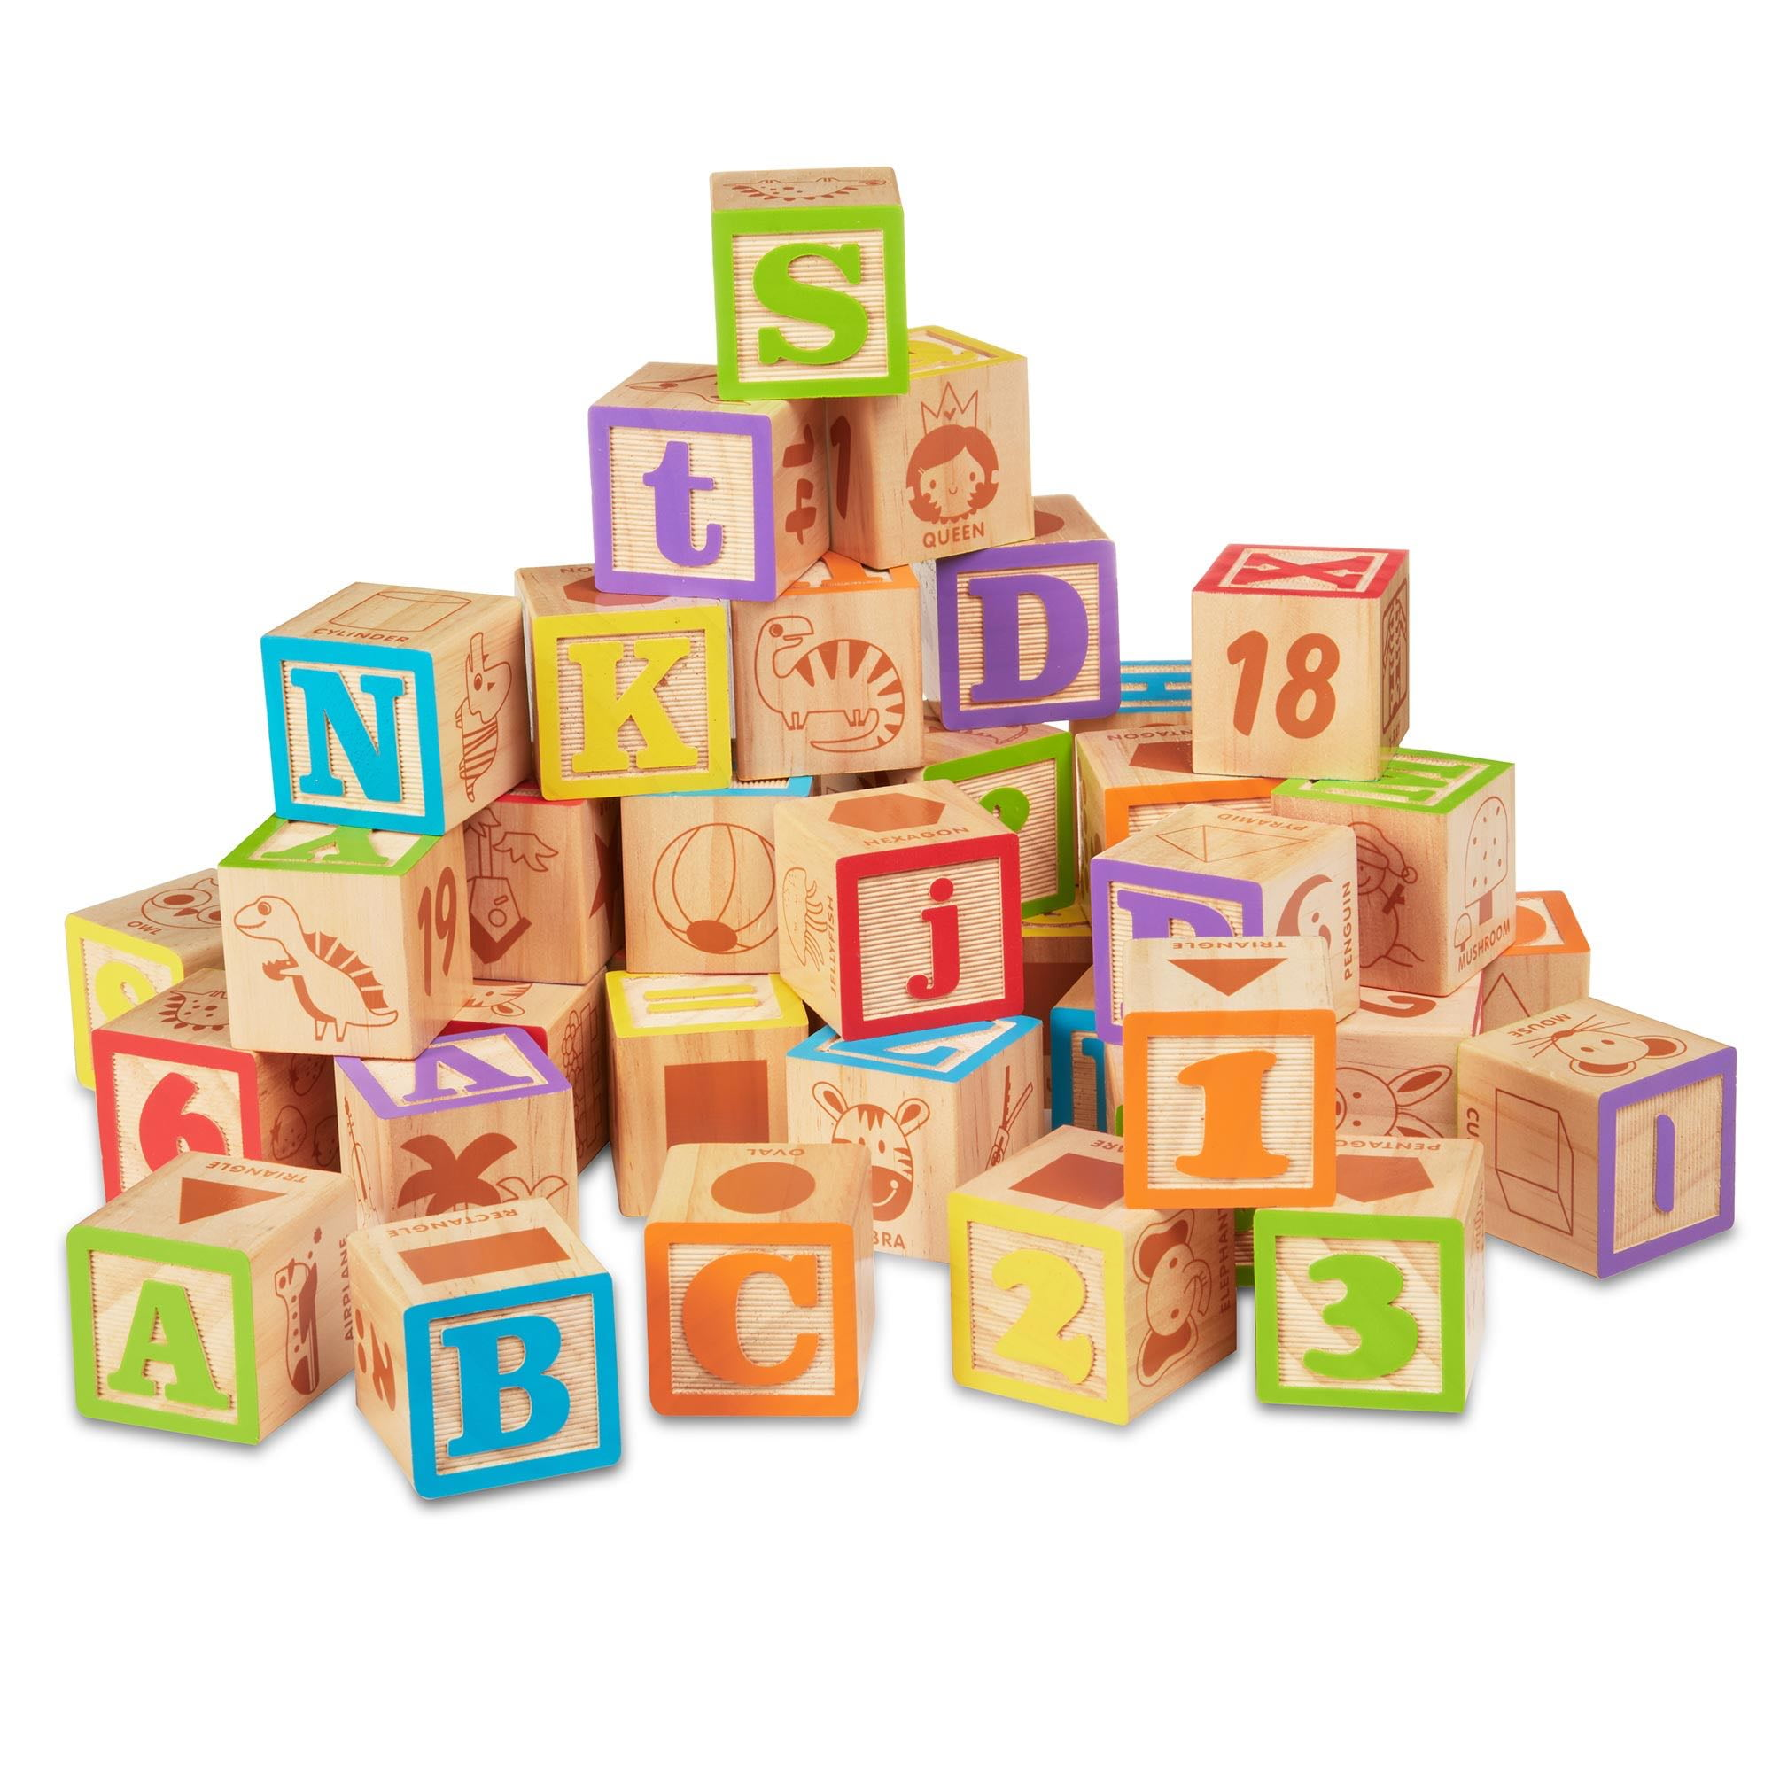
"The Early Catastrophe" The Thirty Million Word Gap
A famous longitudinal study revealed that...
Children's language experiences vary greatly based on socioeconomic status (SES).
Children from low SES homes have been exposed to thirty million fewer words by age four than their peers from higher SES homes.
The study also looked at the language of the same children at ages 9 and 10 and found that…
The children's vocabulary at age 3 was strongly associated with and predictive of language and vocabulary skills .
Hart, Thomas & Risley, Betty, "The Early Catastrophe" American Educator,Spring, 2003.

Slide 13
Early Skills Strongly Linked to Reading
Phonological Awareness
Awareness of Print
Alphabetic Knowledge
Vocabulary
Grammar and Sentence Structure

Slide 14
Early Skills Strongly Linked to Reading
Phonological Awareness
Awareness of Print
Alphabetic Knowledge
Vocabulary
Grammar and Sentence Structure

Slide 15
Phonological Awareness: The ability to recognize and manipulate the sounds in spoken language
Rhyming
Alliteration
Isolating Sounds

Slide 16
Early Skills Strongly Linked to Reading
Phonological Awareness
Awareness of Print
Alphabetic Knowledge
Vocabulary
Grammar and Sentence Structure

Slide 17
Print Awareness or Concepts of Print
Book Conventions
Identifying the front cover, back cover, and pages
Understanding the roles of the author and the illustrator
Locating the title of a book
Knowing how to hold a book
Knowing how to turn the pages in a book
Knowing how to take care of a book
Print Conventions
Tracking from left to right
Tracking from top to bottom
Knowing the difference between letters and words
Knowing that words are made up of letters
Knowing that sentences are made up of words
Understanding the relationship between print and pictures
Print Functions
Understanding that print carries meaning
Knowing that print can be used for different purposes
Cox Campus, Three Categories of Print Awareness

Slide 18
Early Skills Strongly Linked to Reading
Phonological Awareness
Awareness of Print
Alphabetic Knowledge
Vocabulary
Grammar and Sentence Structure

Slide 19
Alphabetic Principle
Knowing that words are made up of letters that represent the sounds of speech
= /c/ + /a/ + /t/
Knowing how to translate the letters in printed words into the sounds they make to read and pronounce words accurately (also called phonological recoding)
cat =

Slide 20
Early Skills Strongly Linked to Reading
Phonological Awareness
Awareness of Print
Alphabetic Knowledge
Vocabulary
Grammar and Sentence Structure

Slide 21
Intentionally Teaching Vocabulary
Can be learned incidentally through reading or listening
Supports reading development and increases comprehension
Should be taught directly and indirectly
Use informal activities, meals, and daily routines to teach
Introduce new vocabulary through books and stories
Preschool children can learn about words that are more sophisticated than those used in everyday life. Think of a more advanced version of an everyday word.
Using Early Childhood Classroom Activities to Build Vocabulary, The Hanen Centre
Notes:
Dinner – raw vegetables, temperature, containers hold different amounts of water. Bathroom – lather the soap, apply sunblock. Play time – connect the train track, travel on the train. “I am tired” becomes “ I am exhausted!”
“It’s time to leave the classroom” becomes “It is time to
depart from the classroom.”

Slide 22
Early Skills Strongly Linked to Reading
Phonological Awareness
Awareness of Print
Alphabetic Knowledge
Vocabulary
Grammar and Sentence Structure

Slide 23
Grammar and Sentence Structure
Strategies to Improve Reading Comprehension
Model
Extend
Recast
Notes:
A number of recent studies have shown that syntax and grammar are predictors of later reading comprehension ability (Logan, 2017).
Knowledge of how grammatical elements such as pronouns, lexical references, and connectives function in sentences allows young children to follow the ideas in a sentence and understand its meaning (Oakhill, Cain, & Elbro, 2015).
Children do not need to know the names of these grammatical terms, but they do need to develop understanding of how sentences work in natural speech and in text.

Slide 24
The Simple View of Reading

Slide 25
Scarborough’s Reading Rope

Slide 26
Daily Language Activities to Support Emergent Literacy

Slide 27
Parents Support Language Development When They..
Talk to your child and name objects, people, and events in the everyday environment.
Repeat your child's strings of sounds (e.g., "dadadada, bababa") and add to them.
Talk to your child during daily routine activities such as bath or mealtime and respond to their questions.
Draw your child's attention to print in everyday settings such as traffic signs, store logos, and food containers.
Introduce new vocabulary words during holidays and special activities such as outings to the zoo, the park, and so on.

Slide 28
Parents Support Language Development When They..
Engage your child in singing, rhyming games, and nursery rhymes.
Read picture and story books that focus on sounds, rhymes, and alliteration (words that start with the same sound, as found in Dr. Seuss books).
Reread your child's favorite book(s).
Focus your child's attention on books by pointing to words and pictures as you read.
Provide a variety of materials to encourage drawing and scribbling (e.g., crayons, paper, markers, finger paints).
Encourage your child to describe or tell a story about their drawing and write down the words.

Slide 29
Conversational Turn Taking (Serve and Return)
Listen with anticipation and remember to respond in turn
Allow children to respond fully
Allow extra wait time for children who need time to process information, and formulate a response
Show interest and enthusiasm for the child's efforts

Slide 30
Reading to a Child Supports Emergent Literacy

Slide 31
Reading to a Child is not Rocket Science – Anyone can do it!
Choose a book that’s right for the child
Is the topic interesting to the child?
Is it developmentally appropriate?
Choose books with repeated text or rhymes.
Choose books with creative illustrations.
Does the book foster connections?
Look for rich and interesting stories and characters.
Remember to include non-fiction books – children love them!

Slide 32
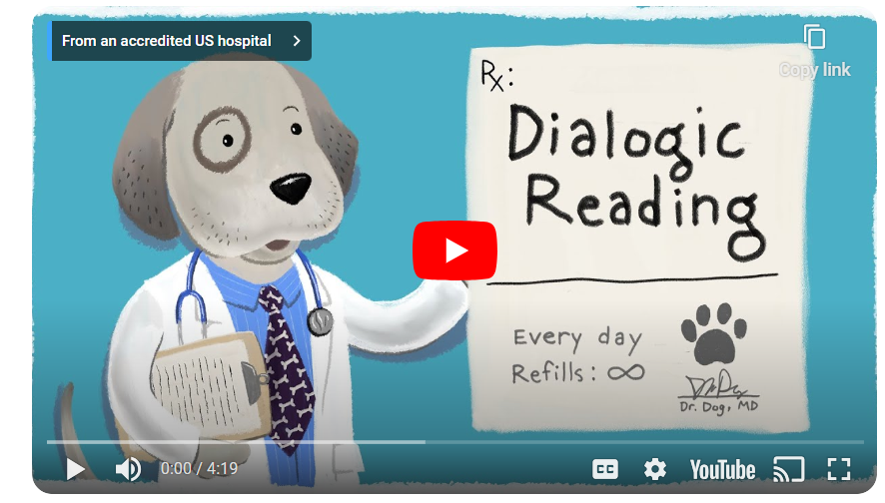
Dialogic Reading
Dialogic Reading (DOGS!) Cincinnati Children’s Hospital

Slide 33
PEER
Prompt the child to say something about the book or page
Ask a question about something on the page
Ask the child to name an object on the page or talk about something in the story
Evaluate the child’s response
Is the answer correct?
Expand by rephrasing or adding information
Expand and recast to build vocabulary
Correct wrong response gently
Repeat the child’s response
Have the child repeat your expansion

Slide 34
Dialogic Reading: CROWD
Completion – Ask the child to complete a sentence or phrase
Recall – Ask about details of what you read
Open-ended questions – Ask about a picture in the book
Wh Questions – Who, What, When, Where, Why
Distancing – Ask questions that relate something in the story to the child’s life

Slide 35
Let’s Practice with Five Little Monkeys
Completion
“Five little monkeys jumping on the ____.”
Recall
What were the monkeys doing?
Open-ended Questions
What happened when the monkeys jumped on the bed?
Wh Questions
Where were the monkeys jumping?
Distancing
Remember when we went to the park, and you jumped on the trampoline?

Slide 36
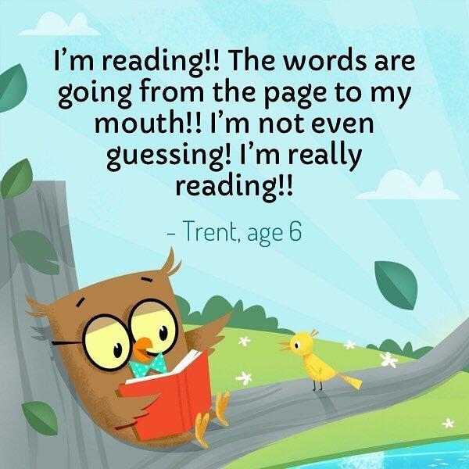

Slide 37
No App to Replace your Lap!

Slide 38
Ga DOE Slide

Slide 39
Contact Information
Barbara Ross
Program Specialist
Preschool/619 Coordinator
Georgia Department of Education
Barbara.ross@doe.k12.ga.us

Slide 40
Resources
Froma P. Roth, Daine R. Paul, Ann Mari Pierotti, “Let’s Talk: For People with Special Communication Needs,” American Speech Language and Hearing Association (ASHA), 2006.
Gough, P. and Turner, W. “Decoding, Reading, and Reading Disability,” Remedial and Special Education,” 1986.
Hart, Thomas & Risley, Betty, “The Early Catastrophe,” America Educator, Spring, 2003.
Harvard University, Center on the Developing Child Website, “Serve and Return,” n.d.
Hennessy, Nancy, “What is the Language Literacy Connection for Skilled Reading?” International Dyslexia Association, 2019.
Lowry, Lauren, “Using Early Childhood Classroom Activities to Build Vocabulary,” The Hanen Centre Website, n.d.
Morgan PL, Meier CR. “Dialogic Reading's Potential to Improve Children's Emergent Literacy Skills and Behavior.” 2008.
National Education Association Website, “Raising Readers: What Parents Can Do,” n.d..
Reading Rockets Website, “Reading 101 for Parents: Your Pre-k Child,” n.d.
Rollins Center for Language and Literacy, Cox Campus, “The 3 Categories of Print Awareness,” 2019.
Romeo, Rachel, Leonard, Julia, Robinson, Sydney, West, Martin, Mackey, Allyson, Rowe, Meredith, and Gabrieli, John, “Beyond the 30-Million-Word Gap: Children’s Conversational Exposure is Associated with Language-Related Brain Function,” Psychological Science, May 2018.
Scarborough, H. S., Neuman, S. B., & Dickinson, D. K. (2001). Connecting early language and literacy to later reading (dis) abilities: Evidence, theory, and practice. Handbook of early literacy research, 1, 97-110.

Slide 41
PEER Strategies

