Slide 1

The Parent
Mentor
Guide
Terms, Tips and Tools
to help you do your
best work
Revised 2025

Slide 2
GAPMP
The Georgia Parent Mentor Partnership is supported by the Georgia Department of Education’s Division of Exceptional Children Outreach Unit.
Parent leaders, moms and dads of children with disabilities, are hired by local school districts, state and charter schools and the Department of Juvenile Justice to work with families, school teams, teachers and the community.
Our goal is to build a bridge between school and home.

Slide 3

PTA Standards of Family Engagement
The PTA developed national standards for successful family school partnerships We use researchbased strategies for family engagement Measure your family engagement work by asking yourself how your trainings are: Welcoming families to partner with schools Promoting and insuring effective Communication Supporting student success Are the activities Speaking Up for every child Are you training families so they can become advocates to Share Power Are you Collaborating with the community and agency partners
You will be asked to report on these different aspects of the Standards, so think about them as you plan your work with families

Slide 4
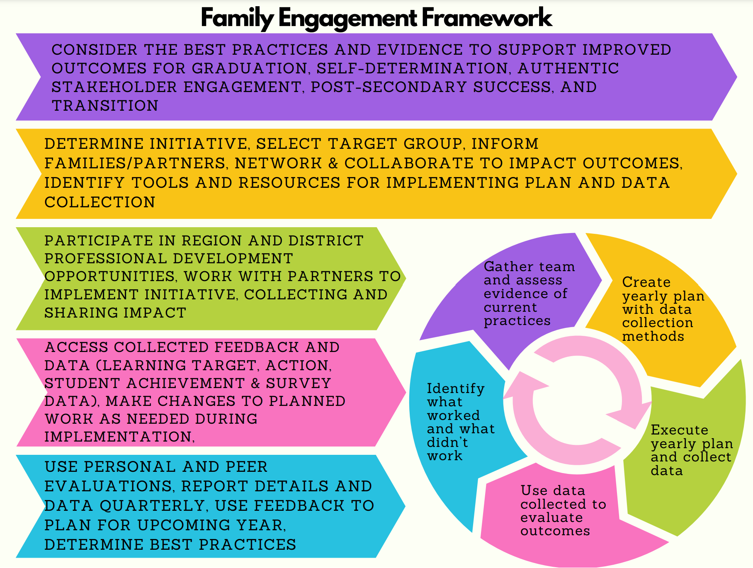
Let Logic be your Guide
This is the Logic Model.
It is a visual tool for planning, implementation and evaluating the ongoing process of family engagement and reporting that are your responsibility as the Parent Mentor in your school district.

Slide 5
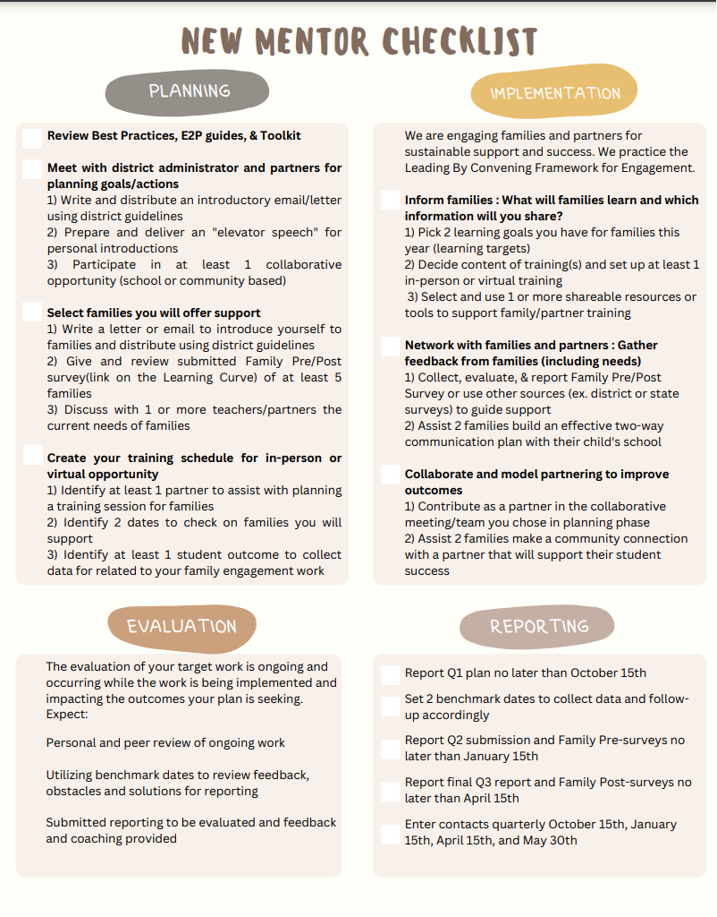
Use a Checklist to Help You Stay on Track

Slide 6
Mandatory Reports
Rookie Mentor Family Engagement Report
Due Oct. 15 Jan. 15 and April 15
Quarterly Contact Reporting
Due Oct. 15 Jan. 15 April 15 Final contact report is due before you leave school in May
Family
Pre and Post
Surveys
Pre surveys are due on Jan. 15
Post are due on April 15

Slide 7
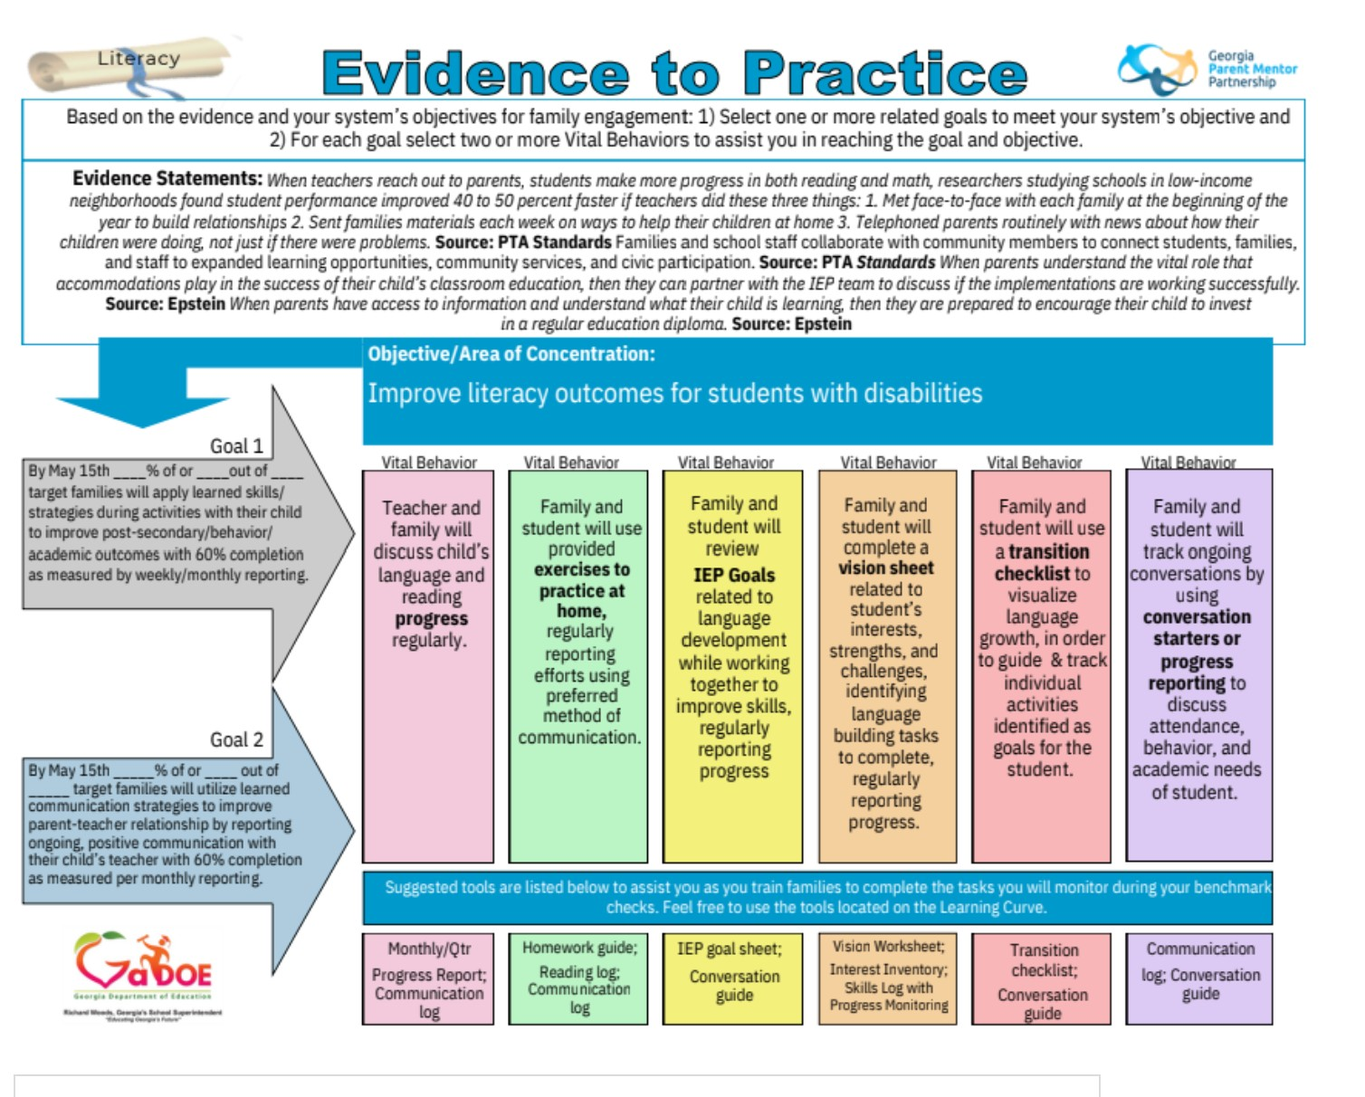
Evidence to Practice or E2P Guides
Once you and your director decide on what your initiative will focus on, then you can use this tool to help you find the Goals, Vital Behaviors and Data collection tools to create research based plans for your work.
Choose from these topics: ABC (Attendance, Behavior, Academic Achievement; Graduation; PS (Post Secondary) Outcomes; Partnerships; Self Determination; Literacy

Slide 8
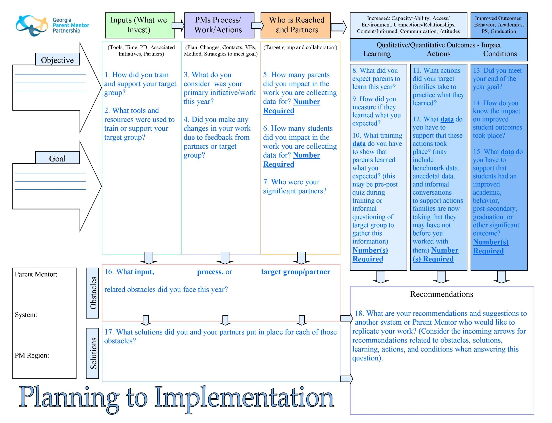
Planning to Implementation or P2I Guides
Use this tool to look ahead while planning by reviewing the guiding questions

Slide 9
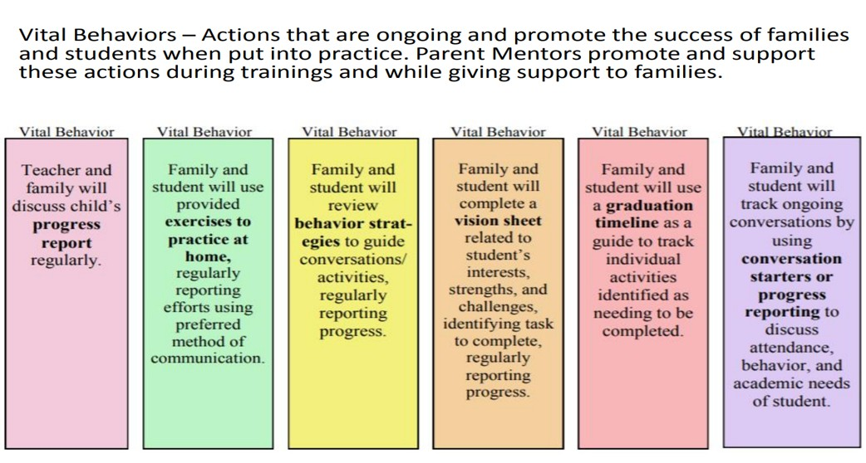
What is a “Vital Behavior” ?
This is the proof that your training has resulted in a change in the habits and behaviors of the families you are working with. This is not about what you trained on, but what families did consistently after the training

Slide 10
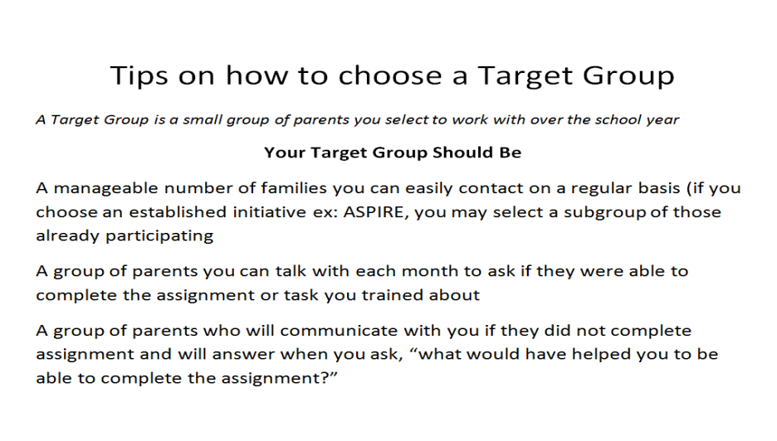
Target Groups
This is the group of families that will be the focus of your trainings, data collection and reporting.
Use the Framework Tools to Train your Target Group:
– Pre Surveys
– Choose big topic from E2P Guide
– Select Vital Behaviors
– Plan Trainings
– Collect data
– Post Surveys

Slide 11
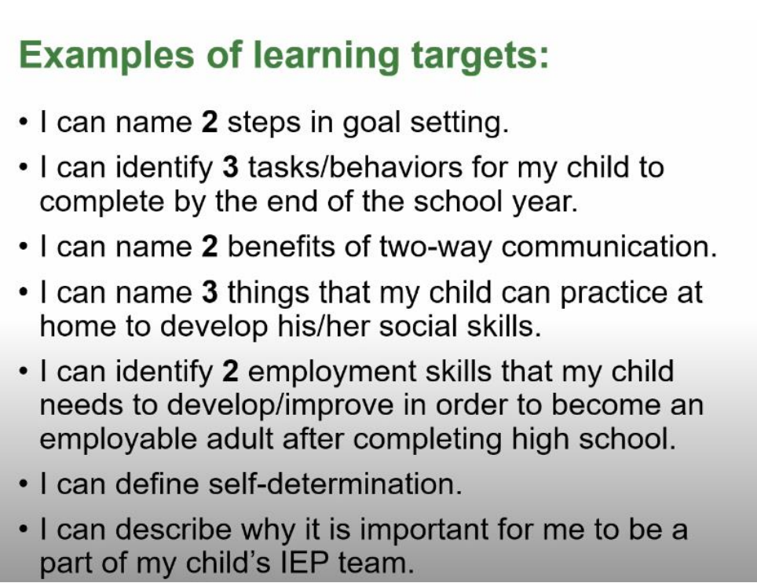
Learning Targets
“I Can” statement for what the family can expect to learn during a learning session tied to the target work and vital behaviors they will be asked to complete. Measured at time of initial training, before family members are asked to do the vital behaviors.

Slide 12

Leading By Convening
Questions related to informing, networking, collaboration, and transforming levels of engagement as part of our use of Leading by Convening Framework for authentic stakeholder engagement practices.
Use this for peer and personal review of target work

Slide 13
Who Can Help Me with My Reports?
Contact your Region Rep (how do I find my region rep?)
Contact our New Mentor/Orientation Guide, Tracy Barber Jones
Find a mentor in your region to help you with reporting questions.

Slide 14
Communication and Information
Looking for links to the GaPMP webpages? https://parentmentors.org/
Looking for shared information about educational resources, parent mentor news and upcoming events?
https://community.gadoe.org

Slide 15
Other Helpful Resources to share with families
Ga Dept. of Education Special Education HELPDesk
SPEDHelpDesk@doe.k12.ga.us
404-656-3963
Parent to Parent of Ga. https://www.p2pga.org/

