Slide 1
G.I.F.T.
Get It Forever Together
Presented by
Jo Ellen Hancock, Parent Mentor
Cherokee County School District

Slide 2
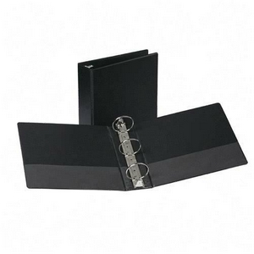
This is a Partnership!
We are here to support and help our families!!
In these Parent Trainings, each family will be provided with a 3 ring binder, tabs and materials to assist you in organizing your records for your child. G.I.F.T – Get It Together Forever!
Each workshop will target a different area to teach you about your child’s upcoming transition to Kindergarten – aka BIG SCHOOL!!
The trainings are designed to teach you some of the information you will need as your child enters his academic journey in Special Education.
This Photo by Unknown Author is licensed under CC BY

Slide 3
Learning Targets
First Parent Training
I can identify 2 people at my child’s school with whom I can communicate
I can use the County website to find information I need

Slide 4
Parent Mentor
Jo Ellen Hancock
Joellen.hancock@cherokeek12.net
770-721-8503
678-310-6198
www.parentmentors.org

Slide 5
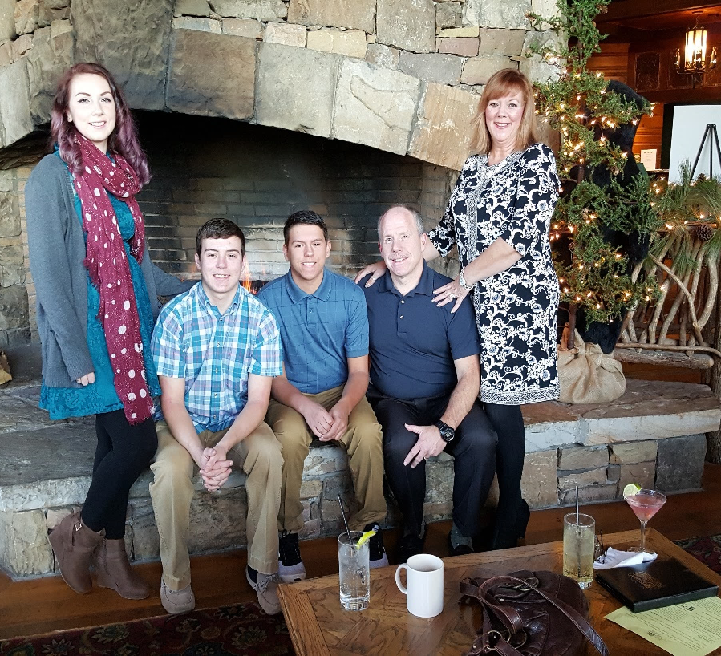
Parent Mentors are parents of a special needs child themselves.

Slide 6
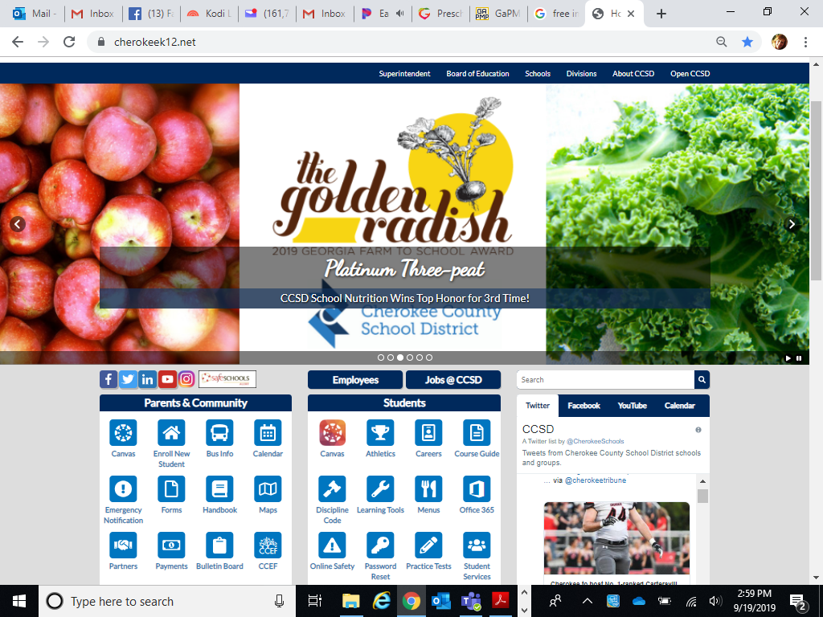
www.cherokeek12.net
Do you know how to access the Cherokee County School Districts website to find information?
Information you can find:
School Calendar
Parent Handbook
Events
School Sponsored Activities
Your schools individual
webpage

Slide 7
Change the titles and modify to fit our needs
Who do I contact to ask questions?
This form will assist you in knowing all the people who will be involved in your child’s academic day and know who to contact.

Slide 8
What did we talk about?
What did we decide?
Use this Communication log to keep track of your communications

Slide 9
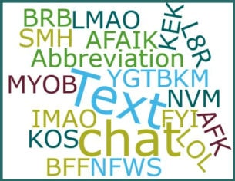
We can help you with that!!
Everything is an acronym these days!!!

Slide 10
Person First Language Starts with You
See the ABILITY
not the disability

Slide 11
Let’s see how we did with our Learning Targets
Name two people at your child’s school with whom you can communicate.
Tell me two things you can find on the County website

