Slide 1
Making Space for Knowledge, Skills, & Attitudes
Stacey Ramirez

Slide 2
Zoom Poll
The Importance of Building Capacity in Schools, Misty M. Kirby, Ph.D.
Notes:
In this Wordel cloud image from the article “The Importance of Building Capacity in Schools, Misty M. Kirby, Ph.D.”, without even reading the article, what do you think are the most important components of Building Capacity in Schools?
Zoom Poll:
what do you think are the most important components of Building Capacity in Schools?
School(s)
Student(s)
Teachers
Achievement
Learning
Leaders
Please share in the chat what you think is missing from this “important” list, if anything? It can be one of the words from her Wordel that is small, but you think should be large to show importance.

Slide 3
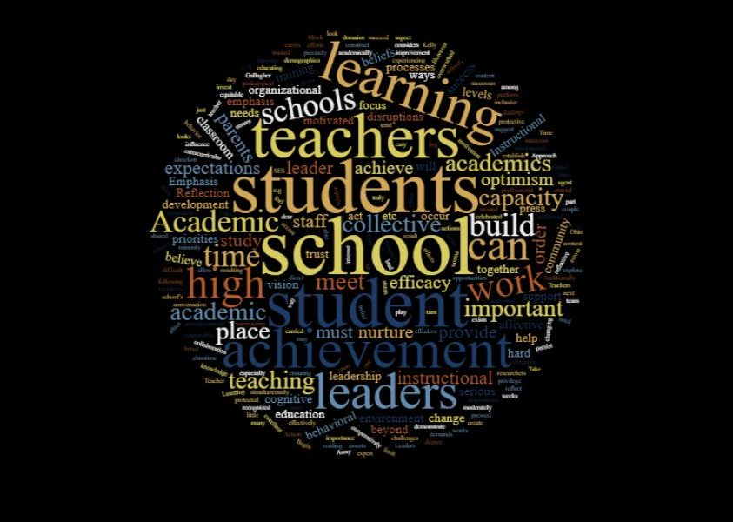
How do we build capacity
In conversation with our esteemed leader Anne Ladd:
It starts with relationships
If you build capacity, then you will set up inclusion.
Notes:
In conversation about the topic, our esteemed leader, Anne Ladd, suggested that building compacity begins with relationships. Once we build capacity through relationship, then we set up the foundations of true inclusion.

Slide 4
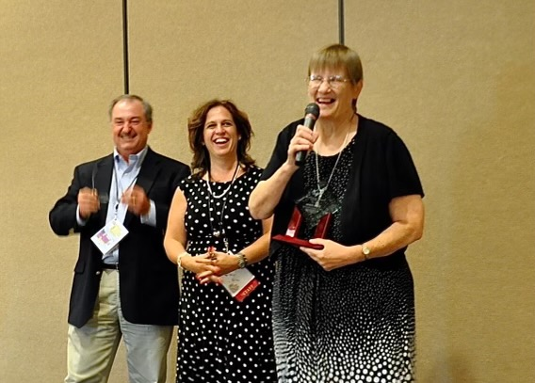
Notes:
That is exactly what she has done with the Parent Mentor Partnership.
Pictured here with Anne are two other experts on building capacity through community relationships. We miss them both very, very much:
Scott Crain, Parent Mentor in Hall County before COVID took him from us.
And the Queen Mother of Family Supports, Dottie Adams.

Slide 6
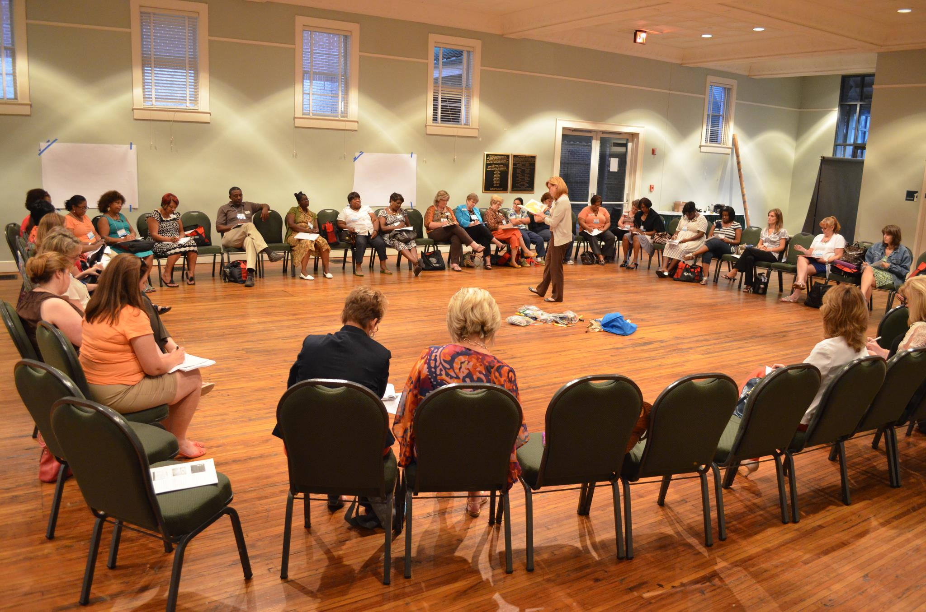

Slide 7
Define Building Capacity Non-Profit
Four critical steps in building capacity:
1. Understand your priorities;
2. Learn from your peers;
3. Utilize technology; and
4. Make it last.
Notes:
Remember these four – we will come back to them in another familiar area.

Slide 8
Starter Kit for Leaders of Social Change
Collective Impact
Social Entrepreneurship: The Case for Definition
The Dawn of System Leadership
Design Thinking for Social Innovation
The Nonprofit Starvation Cycle
Notes:
Leader of Social change have an entire toolkit for capacity building that goes on and on.

Slide 10
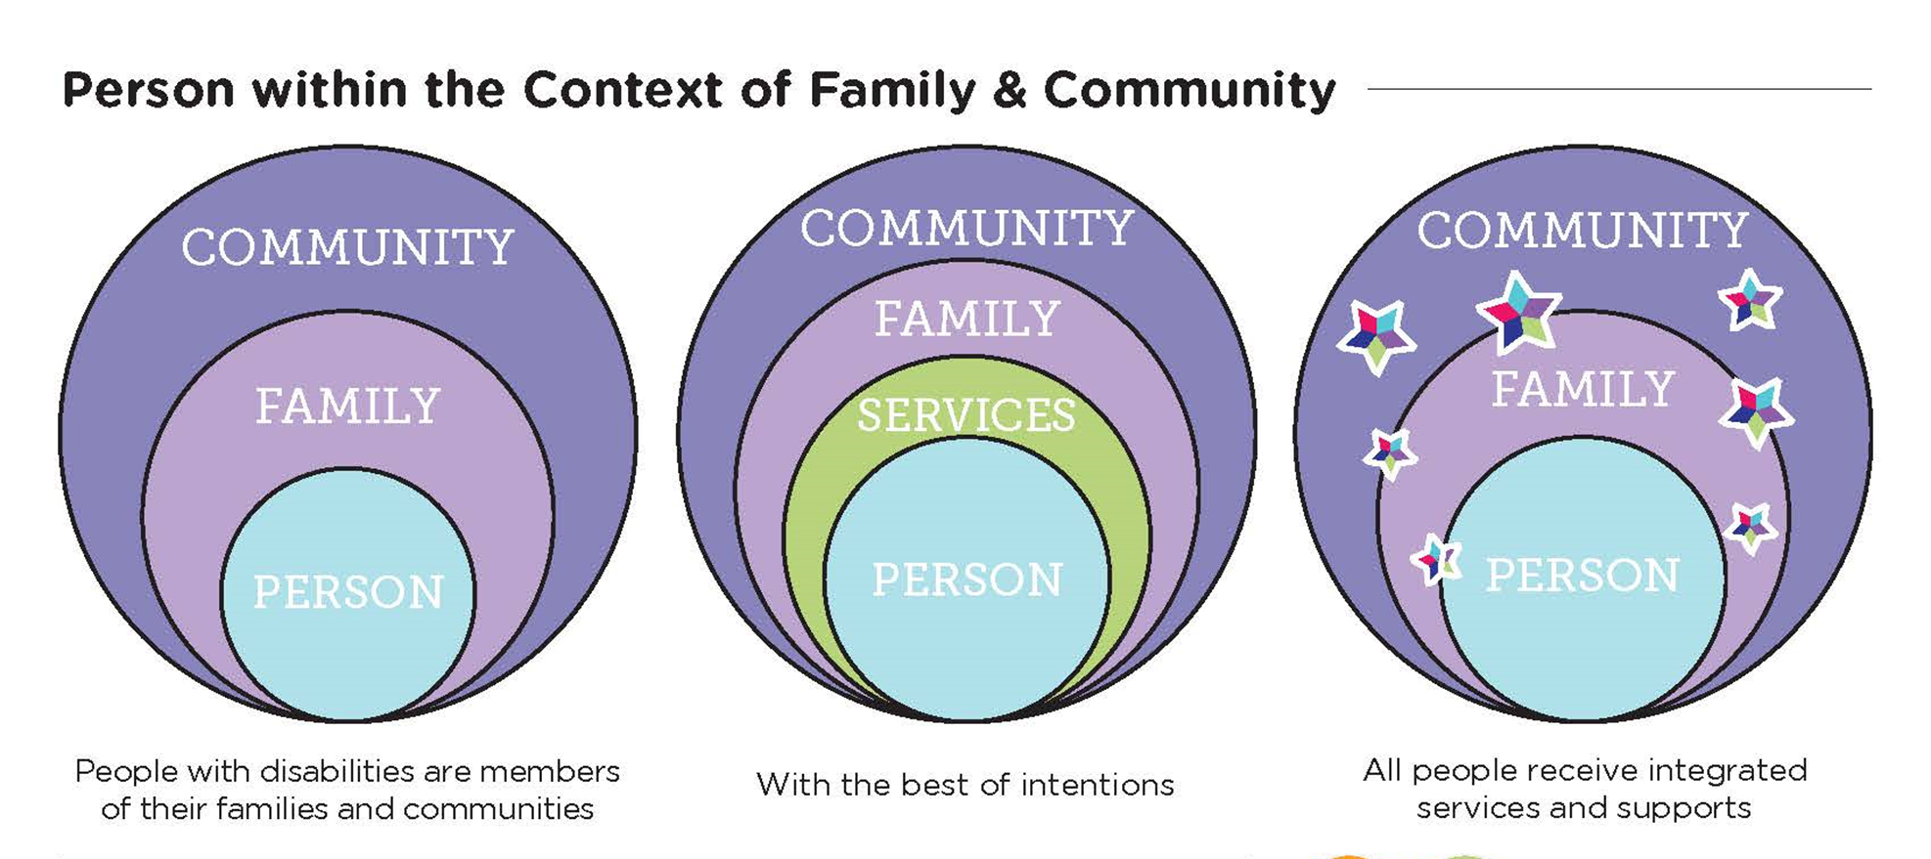
Notes:
You will soon how these critical steps and important strategies can be woven together to become the foundations in which to Build Capacity Today for a Better Tomorrow!

Slide 11
making space to build capacity
Notes:
So how do we make all this happen we've done the lit review we know the basics. We certainly have the heart for the work or we wouldn't be sitting here.
How do we go from disorder in confusion too having a true collective impact. How do we achieve the comment I shared from Anne on our very first slide: “Once we build capacity through relationships, then we set up the foundations of true inclusion.”
It sounds easy enough. Another mentor of mine, Sally Carter, once said “This” (meaning building welcoming communities) isn’t rocket science. It’s just hard work. It takes dedication to a goal and consistent action toward that goal.

Slide 12
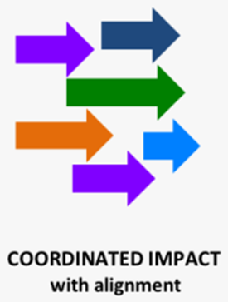
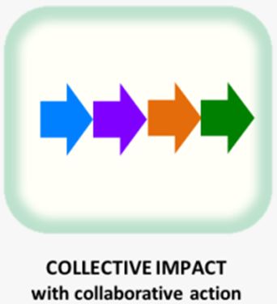
Moving from Isolated Impact to Collective Impact
Zoom Poll
Isolated Impact | Collaboration/ Partnership | Collective Impact
Great initiatives, projects and pilots that do not coordinate with one another Duplication of efforts and inability to compare results and track big picture progress Sense of competition and turf battles | Agreement and excitement around a common “topic” Too often, parties involved only include the “usual suspects” Meetings and working groups typically lack real alignment or shared measures / accountability | All relevant actors work toward the same goal and measure the same things Cross-sector alignment, includes “usual suspects” Organizations actively coordinate their action and share lessons learned
Buffalo County Community Partners: https://bcchp.org/collective-impact-model-for-community-change/
Notes:
Isolated Impact: I wish it worked. For me, it is so easy just sit down think through a project and just get it done without having to worry about what other people say or do OR tell me I can or can’t do!
Collaboration and partnership we see this most often. There's agreement on a topic and like minded usual suspects are sitting around a table – again, and again, and again, sometimes for years. The problem is I don't usually see any real solutions.
Then there's collective impact. This strategy brings together a very diverse group aligned on a central goal, purpose, or mission with coordinated activities and in continuous communication. Takes more effort but the results can be, if facilitated correctly, phenomenal.
Zoom Poll – anonymous:
Whether because you like it or it is the culture of your school district, in which of these do you find yourself working most of the time?
Isolated Impact
Collaboration/Partnership
Collective Impact

Slide 13
RESOURCES
COLLECTIVE IMPACT
Collective Impact Forum
https://www.collectiveimpactforum.org/
Together for Students: Five Key Lessons From Our Collective Impact Initiative, Communities in Schools
https://www.communitiesinschools.org/our-data/publications/publication/five-key-lessons-our-collective-impact
CLEAR IMPACT…Reach Your Peak
https://clearimpact.com/achieving-collective-impact/

Slide 14
Now it is your turn to be brave, be bold, be brilliant in the way you
Build Capacity Today for a Better Tomorrow by
Sharing KNOWLEDGE, Building SKILLS, & Modeling ATTITUDES
with a diverse group outside your “usual suspects” in your communities
Stacey Ramirez
678-313-3177
sramirez@crimminz.com

