Slide 2
P2P & ME!
An Overview of
Programs
and
Services
Supporting Georgia families of children
with disabilities & special healthcare needs
Mitzi Proffitt, Director of Support Services Mitzi@p2pga.org
Sitara Nayak ,VP of Programs Sitara@p2pga.org

Slide 3
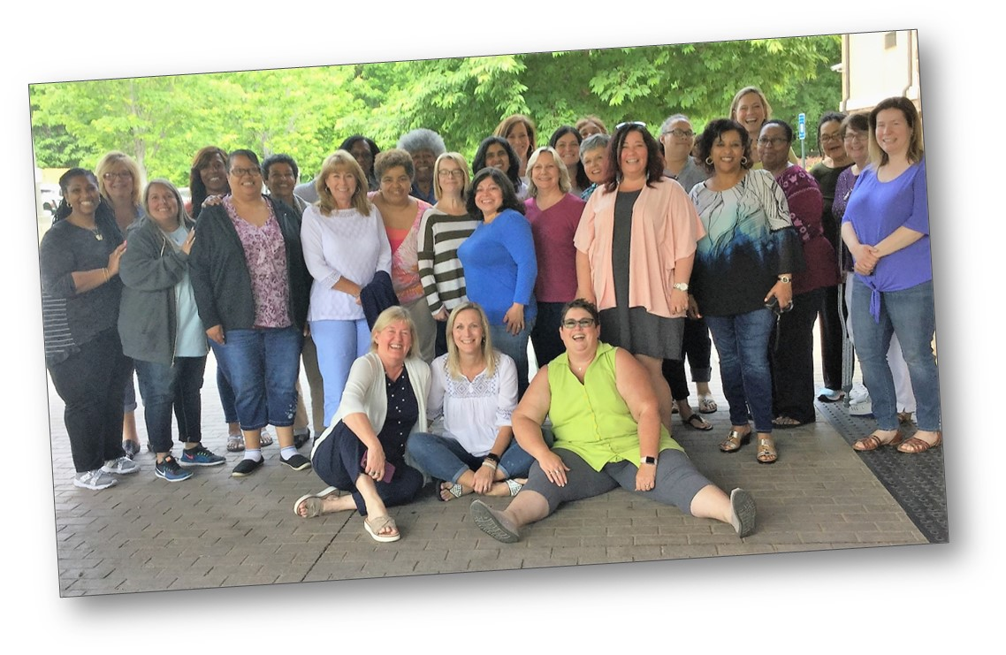
Why Are We Here Today?
Who we are
What we do
How we can help you
How you can help us
WE want to partner with YOU to help YOU and the parents in your community

Slide 4
Who we are . . .
We are Georgia’s Parent Training and Information Center (PTI) – providing information to families so that they can be equal partners in the educational decision-making process.
We are Georgia’s Family to Family Health Information Center (F2F) – providing information to families so they can make better health-related decisions.
We are the Central Directory for Georgia’s Babies Can’t Wait (Part C) Program - assisting families of children in need of early intervention services with information and resources.
We are the State Affiliate of Parent to Parent USA – providing research-based best practice emotional support.

Slide 5
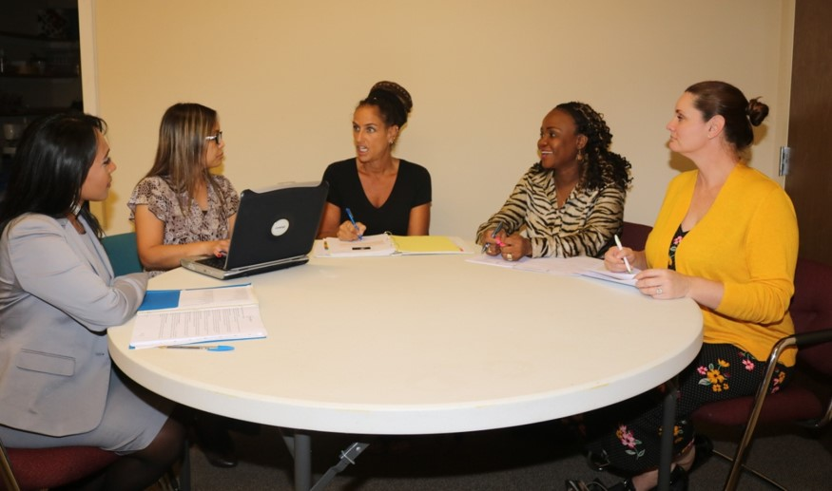
What we do . . .
We encourage families to work with systems . . . not against them!
And we ARE Parents! We are not paid advocates or attorneys!

Slide 6
What we do . . .
7 Core Services
Special Needs Database
Roadmap to Success
Supporting Parents
One-On-One Assistance
Navigator Project
Free Trainings
On-Line Opportunities

Slide 7
1. Special Needs Database
Over 6,000 Resources in 160 Categories!
Access the Database
24 Hours Per Day
Visit our Website
www.p2pga.org
1-800-229-2038 www.p2pga.org

Slide 8
How can YOU help us?
How can WE help you?
Call us & tell your families to call us!
Visit www.p2pga.org, and conduct searches yourself!
Contact us if you see resources need updating!
Contact us if you know of resources not included!

Slide 9
2. P2P Roadmap to Success
Tons of information!
All clickable…
Reading materials
Videos
Links to useful sites
Access the Roadmap 24 Hours Per Day
Visit our Website roadmap.p2pga.org
1-800-229-2038 www.p2pga.org

Slide 10
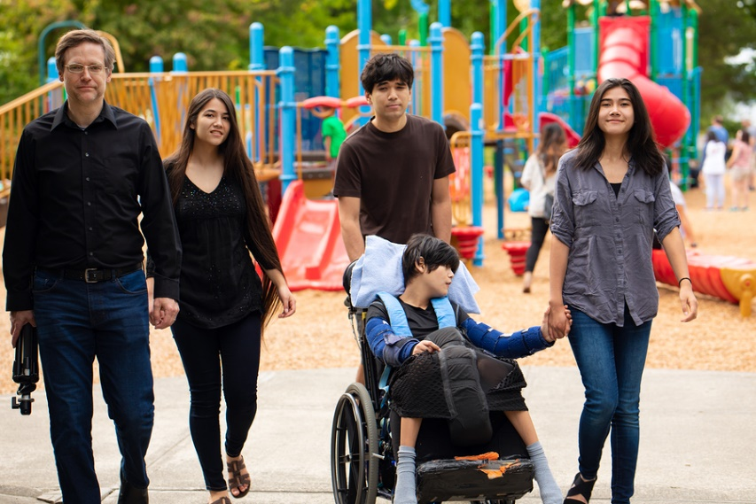
3. Supporting Parents
Trained Parent Volunteers across the state! Great source of Emotional Support!
We train caregivers to support other families when they need it…
We can match parents in a number of ways, including:
child’s disability
medical condition
specific educational issue
health issues
child’s age
1-800-229-2038 www.p2pga.org

Slide 11
How can YOU help us?
How can WE help you?
Call us & tell your families to call for a match!
You and your families can be trained to offer this support to other parents!
Spread the word to families!
Help legitimize the need for emotional support!

Slide 12
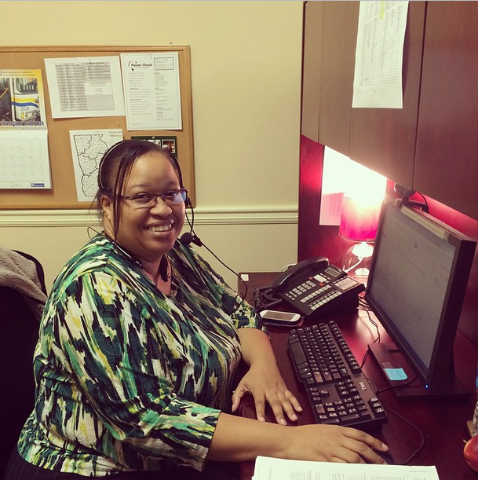
4. One-On-One Assistance
Talk to another PARENT, trained on latest practices, laws, and trends!
Have access to Bilingual staff and resources!
Receive individualized and customized help with:
EDUCATION issues
HEALTH issues
Help based on family needs, from simple to intensive assistance available!
1-800-229-2038 www.p2pga.org

Slide 13
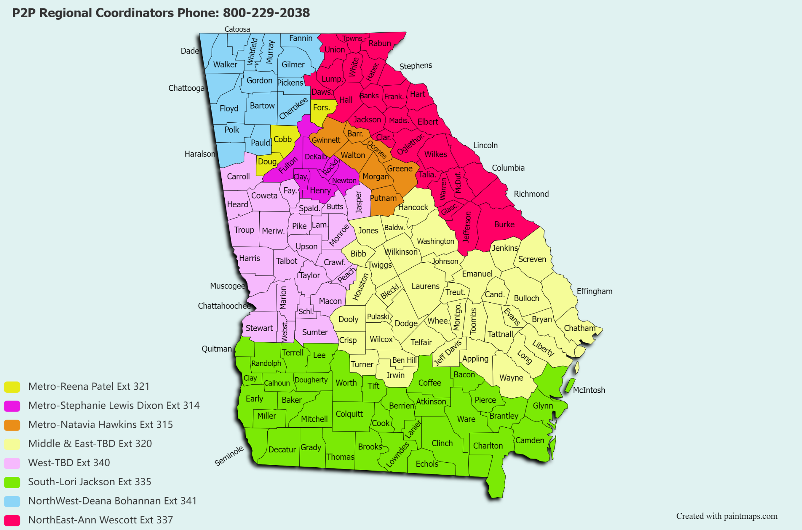
P2P Coordinator Regions

Slide 14
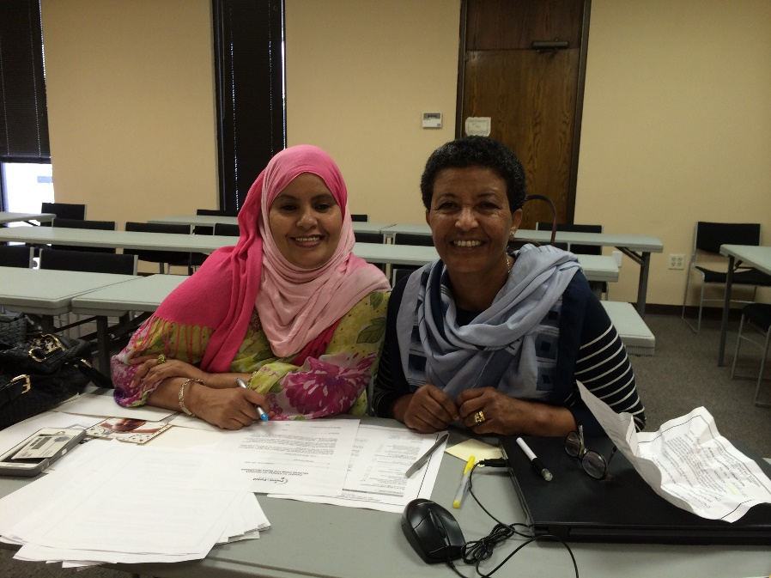
5. Navigator Project
Volunteer Parent Leadership Program of P2P
Training and performance expectations at each level
Designed to build collaborative community leaders
Parent Leadership Training and Practice!
1-800-229-2038 www.p2pga.org

Slide 15
Support Group List
Spanish Speaking Groups
Clayton & Metro Atlanta
Empowerment General Parent Support
Troup & surrounding areas
We are all in this together
For grandparents & Foster parents
Fulton
Rising Beyond Stillness
Columbia & Richmond area
Zariz’a Song
DeKalb & Rockdale
Interested in starting a group?
Contact
Cindy Saylor
cindy@p2pga.org
Connections for Special Parents
Franklin, Banks, Elbert & surrounding areas
Bridges to Understanding
Cobb, Cherokee & Paulding

Slide 16
6. Free Trainings
Just pick up the phone or email us to schedule a training!
P2P Provides
The trainer/trainers
Virtual platform
Full curriculum including PowerPoint and handouts
Fliers for the host to use
Advertising on our calendar of events
Call Toll Free 1-800-229-2038

Slide 17
P2P Trainings
Special Education
A Brief Overview of Special Education
Parental Rights
IEP & Effective Communication
Inclusion in Schools
Understanding the School Discipline Process
Focusing on a Vision and Strengths to get to Measurable Goals
Unlocking Ambitious IEP goals
Health Care
Medicaid and Home and Community-Based Services Basics Overview
Medicaid and Care Management Organizations (CMOs)
Transition to Adult Healthcare
Medicaid & KB Waiver
Medicaid and NOW/COMP Waiver

Slide 18
P2P Trainings
Assistive Technology
Assistive Technology for school age children
Assistive Technology for Young Children
Transitions
Transition at age 3
Transition from High School
Keys to help your teen get a first job
Transition from Elementary to Middle school
Advocacy
Skills that help empower you
Youth development-Self Determination
Webinars
Topical Sessions on a wide variety of topics by parents and professionals

Slide 19
How can YOU help us?
How can WE help you?
Call us & schedule a training!
We provide accurate and meaningful information in a variety of formats.
Encourage families and professionals to attend our trainings!
Suggest OR train on a topic via our webinars!

Slide 20
7. Online Opportunities
P2P Email News Blasts
Visit us at www.p2pga.org

Slide 21
What you can do for us…
Collaborate with us to help families
Tell your families to call us!
Use our Special Needs Database
Host Trainings!
Refer potential Supporting Parents
Become a Supporting Parent!
Start a support group or refer interested parents!
Check out our website www.p2pga.org
Follow us on Facebook/Twitter!
Donate time, talents, or money!

Slide 22
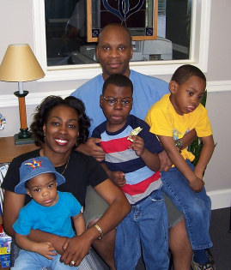
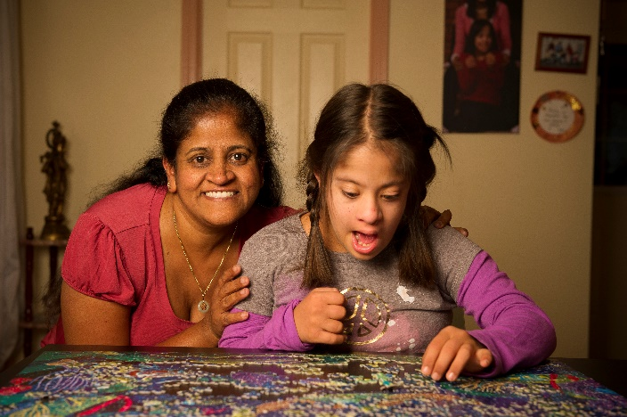
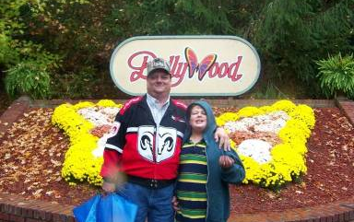
Why Are We Here Today?
WE want to partner with YOU to help YOU and the parents in your community

Slide 23
P2P & ME!
Thank you for listening!
Remember,
help is just a phone call or click
away…
Main Number: 800-229-2038 Website: www.p2pga.org
Other contacts:
Mitzi Proffitt, Director of Support Services Mitzi@p2pga.org
Sitara Nayak ,VP of Programs Sitara@p2pga.org

Slide 24
P2P & ME!
An Overview of
Programs
and
Services
Supporting Georgia families of children
with disabilities & special healthcare needs
Mitzi Proffitt, Director of Support Services Mitzi@p2pga.org
Sitara Nayak ,VP of Programs Sitara@p2pga.org

Slide 25
Why Are We Here Today?
Who we are
What we do
How we can help you
How you can help us
WE want to partner with YOU to help YOU and the parents in your community

Slide 26
Who we are . . .
We are Georgia’s Parent Training and Information Center (PTI) – providing information to families so that they can be equal partners in the educational decision-making process.
We are Georgia’s Family to Family Health Information Center (F2F) – providing information to families so they can make better health-related decisions.
We are the Central Directory for Georgia’s Babies Can’t Wait (Part C) Program - assisting families of children in need of early intervention services with information and resources.
We are the State Affiliate of Parent to Parent USA – providing research-based best practice emotional support.

Slide 27
What we do . . .
We encourage families to work with systems . . . not against them!
And we ARE Parents! We are not paid advocates or attorneys!

Slide 28
What we do . . .
7 Core Services
Special Needs Database
Roadmap to Success
Supporting Parents
One-On-One Assistance
Navigator Project
Free Trainings
On-Line Opportunities

Slide 29
1. Special Needs Database
Over 6,000 Resources in 160 Categories!
Access the Database
24 Hours Per Day
Visit our Website
www.p2pga.org
1-800-229-2038 www.p2pga.org

Slide 30
How can YOU help us?
How can WE help you?
Call us & tell your families to call us!
Visit www.p2pga.org, and conduct searches yourself!
Contact us if you see resources need updating!
Contact us if you know of resources not included!

Slide 31
2. P2P Roadmap to Success
Tons of information!
All clickable…
Reading materials
Videos
Links to useful sites
Access the Roadmap 24 Hours Per Day
Visit our Website roadmap.p2pga.org
1-800-229-2038 www.p2pga.org

Slide 32
3. Supporting Parents
Trained Parent Volunteers across the state! Great source of Emotional Support!
We train caregivers to support other families when they need it…
We can match parents in a number of ways, including:
child’s disability
medical condition
specific educational issue
health issues
child’s age
1-800-229-2038 www.p2pga.org

Slide 33
How can YOU help us?
How can WE help you?
Call us & tell your families to call for a match!
You and your families can be trained to offer this support to other parents!
Spread the word to families!
Help legitimize the need for emotional support!

Slide 34
4. One-On-One Assistance
Talk to another PARENT, trained on latest practices, laws, and trends!
Have access to Bilingual staff and resources!
Receive individualized and customized help with:
EDUCATION issues
HEALTH issues
Help based on family needs, from simple to intensive assistance available!
1-800-229-2038 www.p2pga.org

Slide 35
P2P Coordinator Regions

Slide 36
5. Navigator Project
Volunteer Parent Leadership Program of P2P
Training and performance expectations at each level
Designed to build collaborative community leaders
Parent Leadership Training and Practice!
1-800-229-2038 www.p2pga.org

Slide 37
Support Group List
Spanish Speaking Groups
Clayton & Metro Atlanta
Empowerment General Parent Support
Troup & surrounding areas
We are all in this together
For grandparents & Foster parents
Fulton
Rising Beyond Stillness
Columbia & Richmond area
Zariz’a Song
DeKalb & Rockdale
Interested in starting a group?
Contact
Cindy Saylor
cindy@p2pga.org
Connections for Special Parents
Franklin, Banks, Elbert & surrounding areas
Bridges to Understanding
Cobb, Cherokee & Paulding

Slide 38
6. Free Trainings
Just pick up the phone or email us to schedule a training!
P2P Provides
The trainer/trainers
Virtual platform
Full curriculum including PowerPoint and handouts
Fliers for the host to use
Advertising on our calendar of events
Call Toll Free 1-800-229-2038

Slide 39
P2P Trainings
Special Education
A Brief Overview of Special Education
Parental Rights
IEP & Effective Communication
Inclusion in Schools
Understanding the School Discipline Process
Focusing on a Vision and Strengths to get to Measurable Goals
Unlocking Ambitious IEP goals
Health Care
Medicaid and Home and Community-Based Services Basics Overview
Medicaid and Care Management Organizations (CMOs)
Transition to Adult Healthcare
Medicaid & KB Waiver
Medicaid and NOW/COMP Waiver

Slide 40
P2P Trainings
Assistive Technology
Assistive Technology for school age children
Assistive Technology for Young Children
Transitions
Transition at age 3
Transition from High School
Keys to help your teen get a first job
Transition from Elementary to Middle school
Advocacy
Skills that help empower you
Youth development-Self Determination
Webinars
Topical Sessions on a wide variety of topics by parents and professionals

Slide 41
How can YOU help us?
How can WE help you?
Call us & schedule a training!
We provide accurate and meaningful information in a variety of formats.
Encourage families and professionals to attend our trainings!
Suggest OR train on a topic via our webinars!

Slide 42
7. Online Opportunities
P2P Email News Blasts
Visit us at www.p2pga.org

Slide 43
What you can do for us…
Collaborate with us to help families
Tell your families to call us!
Use our Special Needs Database
Host Trainings!
Refer potential Supporting Parents
Become a Supporting Parent!
Start a support group or refer interested parents!
Check out our website www.p2pga.org
Follow us on Facebook/Twitter!
Donate time, talents, or money!

Slide 44
Why Are We Here Today?
WE want to partner with YOU to help YOU and the parents in your community

Slide 45
P2P & ME!
Thank you for listening!
Remember,
help is just a phone call or click
away…
Main Number: 800-229-2038 Website: www.p2pga.org
Other contacts:
Mitzi Proffitt, Director of Support Services Mitzi@p2pga.org
Sitara Nayak ,VP of Programs Sitara@p2pga.org

