Slide 2
The Importance of Self-Determination Building in Transition Programming
Guidance for Families of Students with Disabilities
Elise James
Program Specialist Transition Postschool Outcomes and Section 504
ejames@doe.k12.ga.us
LaTanya Barkley-Washington
Program Manager
Outreach, IDEA Ombudsman
latanya.barkley@doe.k12.ga.us

Slide 3
The Importance of Self-Determination Building in Transition Programming
Guidance for Families of Students with Disabilities
Elise James
Program Specialist Transition Postschool Outcomes and Section 504
ejames@doe.k12.ga.us
LaTanya Barkley-Washington
Program Manager
Outreach, IDEA Ombudsman
latanya.barkley@doe.k12.ga.us

Slide 4
Self-Determination is…
… a concept reflecting the belief that all individuals have the right to direct their own lives
…acting as the primary causal agent in one’s life free from undue external influence or interference
(Wehmeyer, 1996)
…reflected in a demonstration of self-determined behavior (skills)
Notes:
Slide need no additional explanation

Slide 5
Self-Determination Skills
Self-regulation
Self-advocacy
Self-awareness
Self-efficacy
Choice-making
Decision-making
Problem-solving
Goal setting and planning
Notes:
Defined in Self-Determination:
Self-regulation: controlling one's behavior, emotions
Self-advocacy: expressing oneself or one's views or interests as well as standing up for oneself without aggression
Self awareness: understanding your strengths and weaknesses, knowing how to ameliorate weaknesses, and knowing who you are
Self-efficacy: an individual's belief that they are capacity (requires a focus on strengths; not disabilities)
Choice-making: having options; sometimes beyond more than one
Decision-making: using a process to gather information to make a decision including accessing potential barriors
Problem-solving: finding solutions for ways to do things (more than one way to skin a cat)
Goal-setting and planning: process of identifying something you want to accomplish, creating actions to work towards it, and setting deadlines
While these seem like they are above pre-school ability, the activities to begin the development of these skills is not.

Slide 6
Benefits for Students…
Develop an understanding of strengths and challenges while building on ability to be a self-advocate in school and in life,
Learn about their disability, including how to talk with others about it,
Learn about accommodations and what types they need to succeed,
Develop skills necessary for independent/interdependent decision-making,
More likely to earn a higher income one year after graduation,
More likely to be employed one year after graduation, and
More likely to attend and complete college.

Slide 7
What Does the Research Show? #1
Self-determination is a necessary skill for students to transition successfully to their postschool environment.
For students to acquire self-determination skills, they need instruction and safe settings in which to practice such skills. (Gradoudas, 2014)
Providing support for student self-determination in school settings is one way to enhance student learning and improve important post-school outcomes. (Deci & Ryan, 2004)

Slide 8
What Does the Research Show? #2
Provides skill for student to actively participate in the Individualized Education Planning process.” (Deci & Ryan, 2004)
Building self-determination skills in school was generalized to postschool participation in college and the workplace. (Eddy, 2010)
Increased attention has been directed toward understanding the development of self-determination in young children.
Families play a critical role in this process.

Slide 9
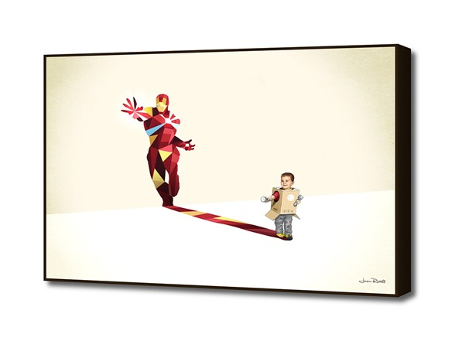
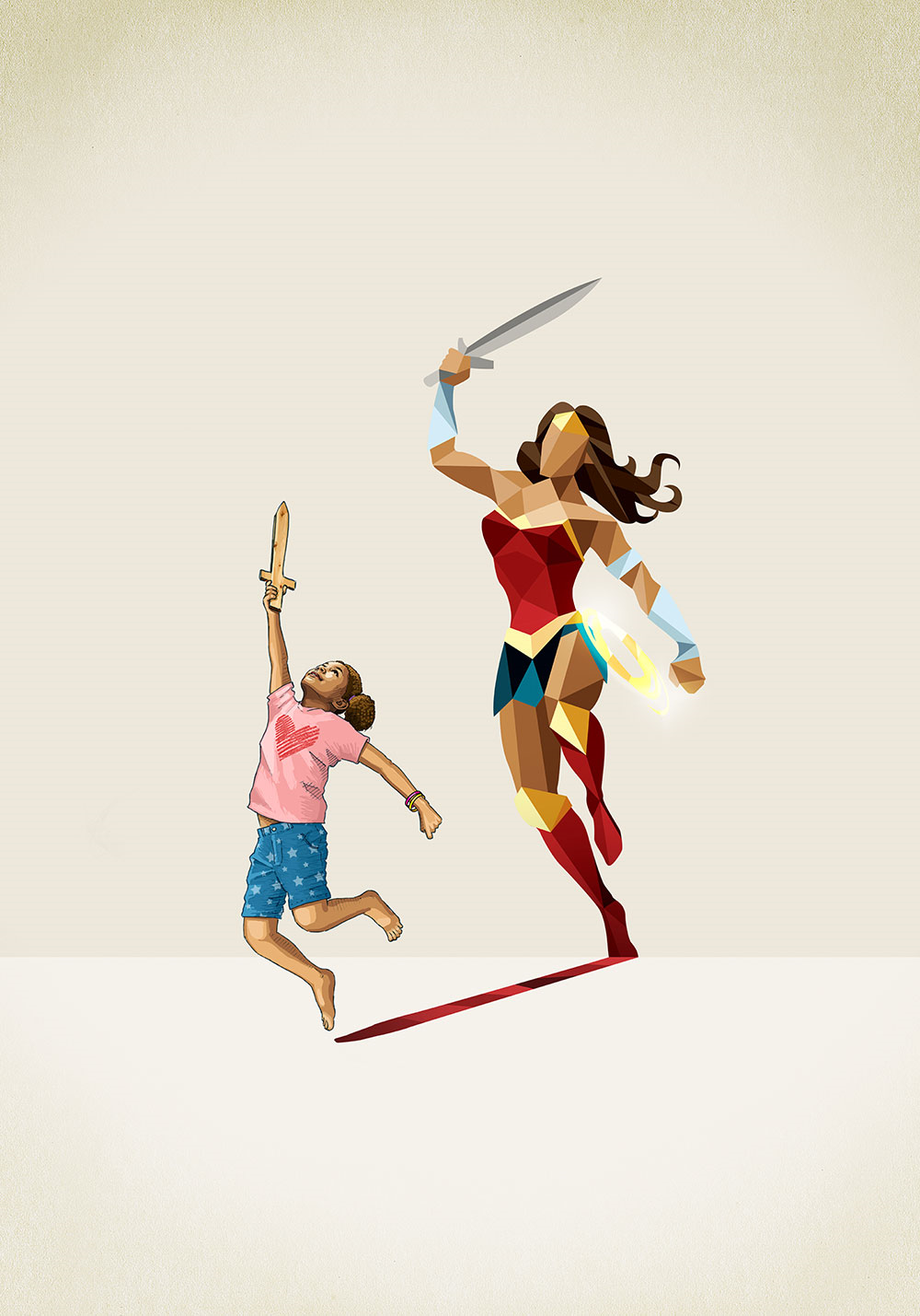
With Self-Determination Comes Great Power
Notes:
Emphasize how students will be their own superheroes in their lives as adults
We want to equip our students with the skills necessary to be global citizens, employable and contributing members of their communities, and able to support themselves and the families they will create.
This was OSERS original intent when establishing:
the development of the original Bridges from School to Work transition initiative (1985),
the facilitation of the self-determination movement (1987),
the Reauthorization of IDEA 04 which included specific language for transition, and
the authorization of Workforce Innovation and Opportunity Act (2014) requiring vocational rehabilitation services to allot 15% of their budget for transition planning in collaboration with special education for students and youth with disabilities.

Slide 10
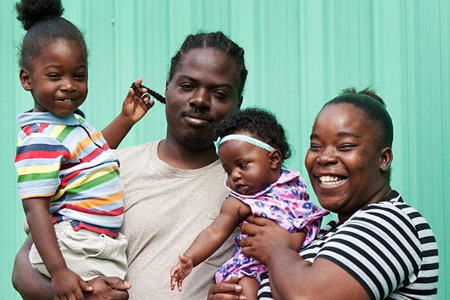
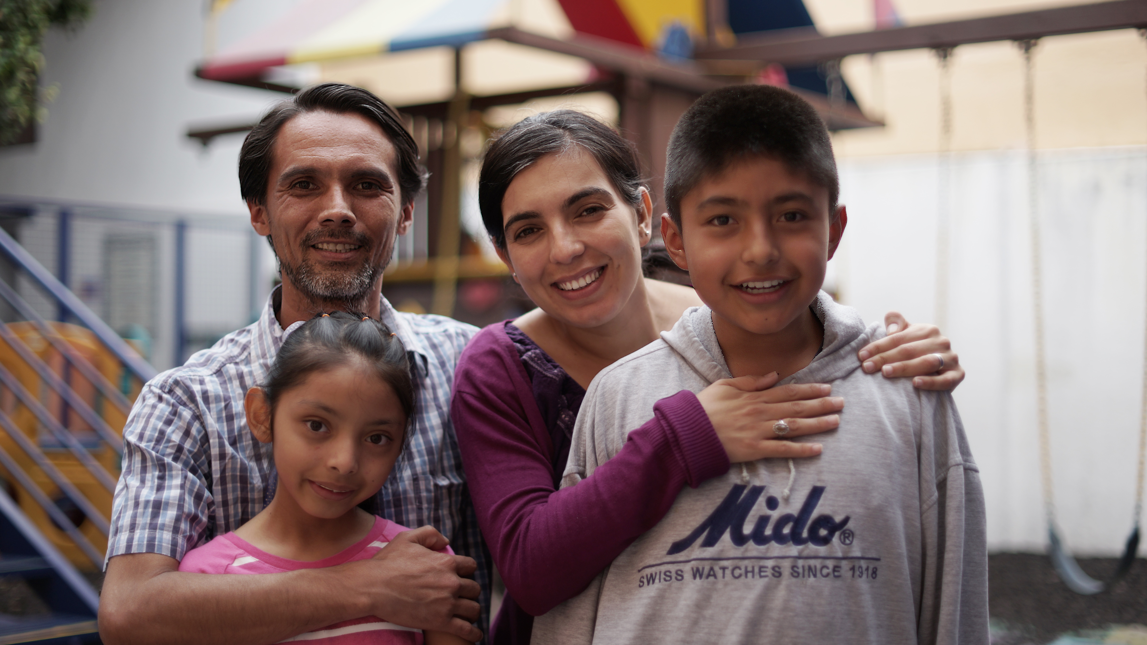
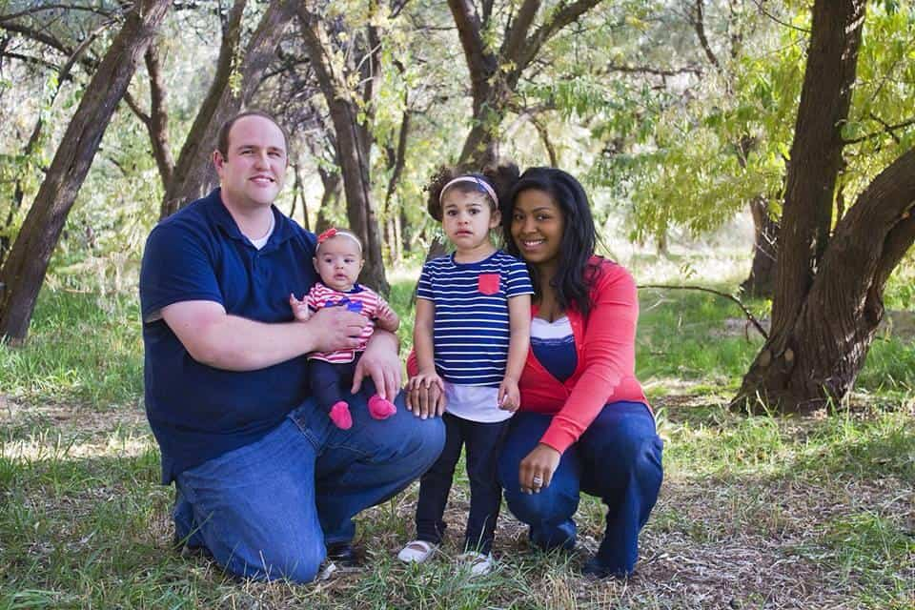
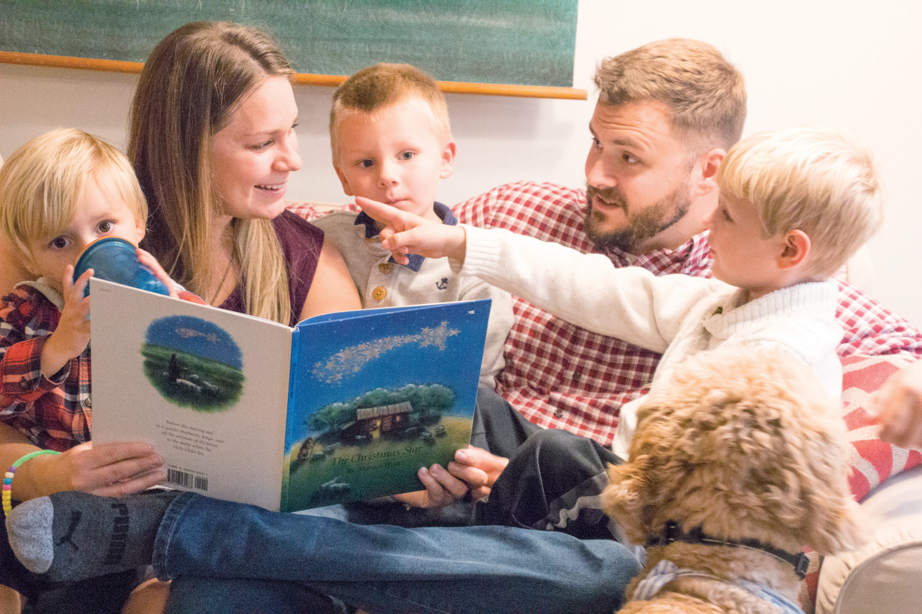
How Can Families Help?

Slide 11
Building Self-Determination in Preschool and Kindergarten
It’s Never Too Early To Get Started
Notes:
Self-determination is important for all students but especially for students with disabilities who need to have these skills taught with intentionality.
The research shows that disability does not preclude a student from developing self-determination.
However, research does show that SWD have poorer outcomes (academic, graduation, employment, etc) than their non-disabled peers when neither groups receive self-determination.
They meet and excel at greater rates than their non-disabled peers when they receive intentional instruction and support in building self-determination skills and their non-disabled peers do not.
If at the age of 16 (or earlier depending on other mandates) students are expected to participate in a meaningful way in their transition planning and IEP meetings, they need to begin developing these skills which align with IEP and transition components.

Slide 12
Supporting Parents Through the Process
Parents need to be on board to reinforce the practices at home
Encouraging Self-Determination at a Young Age (early childhood focus ends at 3.34)
Interventions to be used at home in the same manner
I’m Determined in Preschool

Slide 13
Preschool Activities#1
Set high expectations for the child with the school, providers, and practitioners
Reinforce appropriate communication with adults
Request that your child participate in the IEP process as is age appropriate
Help child identify positive attributes
Promote behaviors that allow the child to be successful within daily routines
Increase activities as the child gets older

Slide 14
Preschool Activities:#2
Provide opportunities to:
Follow directions
Make intentional choices
Make decisions
Encourage goal setting across the child’s environment
Builds independence/intra-dependance
Help student evaluate themselves and provide solutions for doing better.

Slide 15
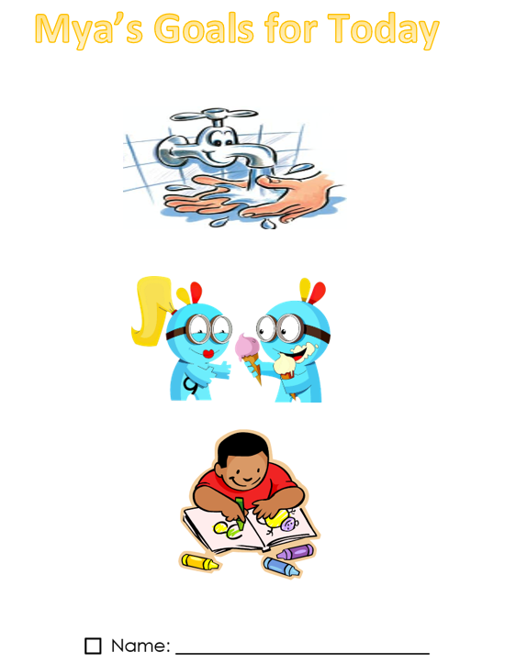
Goal Setting Sample
Pictorial rubrics for goals
Let students choose goals and pictures
Set them up for success
Keep it:
age appropriate
short term

Slide 16
Sample Evaluation of Performance

Slide 17
Consistency and Focus
Be consistent with:
Locations used in the natural environment
Times for skill practice
Reinforcement of the desired behavior
Be sure to focus on monitoring the child’s:
Interests
Preferences
Strengths
Areas where support is needed

Slide 18
Building Self-Determination in Elementary School Upping the Ante

Slide 19
Elementary Activities #1
Set high expectations for the child with the school, providers, and practitioners
Request that your child participate in the IEP process as is age appropriate
Get your child to start talking about the future based on their strengths
Use online interest inventories
Provide opportunities for doing tasks associated with their interests and/or desired careers

Slide 20
Elementary Activities #2
Initiate opportunities to socialize and/or volunteer with non-disabled peers
Start reinforcing executive functioning skills
Use an alarm clock
Use charts for getting things done
Use visual charts
Get other family members, friends, community members and businesses involved
Focus on strengths

Slide 21
Good Day Plan I’m Determined (Virginia)

Slide 22
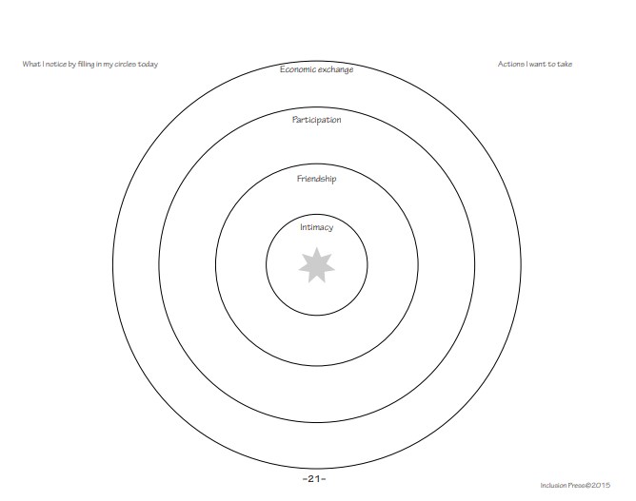
Circle of Friends Template

Slide 23
Reinforce and Focus #1
Reinforce strengths
Vary career exploration
Start creating the circle of supports
Be sure to focus on monitoring the child’s:
Interests
Preferences
Strengths
Areas where support is needed

Slide 24
Building Self-Determination in Middle School
Moving from Adult to
Student-Focus

Slide 25
Pre-Teen (+) Activities #1 #2
Set high expectations for the child with the school, providers, and practitioners
Encourage the child to take more of a lead in the IEP process
Talk about strengths, challenges,
Discuss accommodations and how they are associated with their support needs (disability)
Reinforce appropriate communication with adults
Provide opportunities for self-advocacy

Slide 26
Pre-Teen (+) Activities #2
Participate in the transition planning process
Reinforce and support the child’s desires
Provide practice for self-advocating
Seek opportunities in the community (programs, community activities, family business, volunteerism) for building postsecondary skills

Slide 27
Pre-Teen(+) Activities #3
Assist the child in setting goals for
Course completion
Independent/Inter-dependent living
Recreation
Transition
Assist the child to:
Create action steps
Evaluation actions
Find solutions to barrier to goal attainment

Slide 28
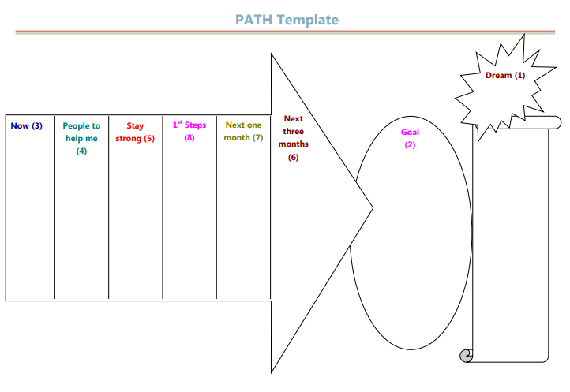
Planning Alternative Tomorrows with Hope (PATH)

Slide 29
Self-Determined Learning Model of Instruction Phase 1 Template

Slide 30
Reinforce and Focus #2
Encourage the child’s creativity and entrepreneurial thinking
Optimize strengths through practice
Explore the child’s suggested accommodations
Emphasize the child being the problem-solving

Slide 31
Building Self-Determination in High School Through Age 22 Own It!

Slide 32
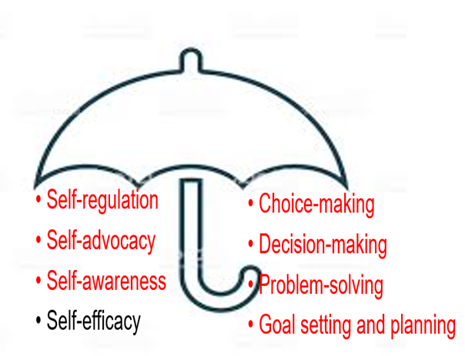
High School - 22 Activities#1 #2
Set high expectations for the child with the school, providers, and practitioners
Encourage the child to take more of a lead in the IEP process
Talk about strengths, challenges, accommodations
Create transition goals for employment, education, daily living
Discuss rights and responsibilities as an adult
Have the hard conversations
Foster decision making through:
Financial literacy
Registering to vote

Slide 33
High School- 22 Activities#1 #2
Assist child to visit postsecondary environments
Apartments
Schools
Banks
Recreation sites
Health facilities
Participate in
Community Activities
Churches
Social engagements

Slide 34
Goal Plan Template

Slide 35
Voting Assistance for People with Disabilities

Slide 36
Prioritize
Independence/ Inter-dependence
Adult goals and dreams
Mobility
Self-advocacy

Slide 37
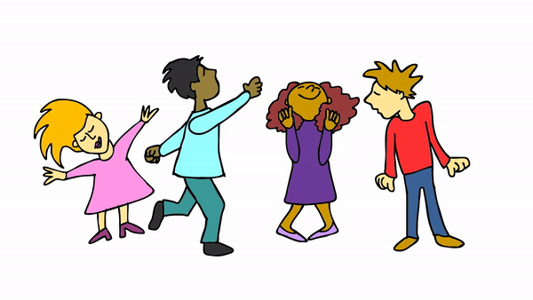
Questions?

Slide 38
Resources
Person-Centered Planning Facilitator's Guide
GaDOE list of Virtual Self-Determination Activities
Self-Determined Learning Model of Instruction: Lesson Plans
Coastal GLRS and Southeast GLRS product

Slide 39
Contact Information
Elise James
Program Specialist Transition Postschool Outcomes and Section 504
404-326-0421
ejames@doe.k12.ga.us
LaTanya Barkley-Washington
Program Manager
Outreach, IDEA Ombudsman
latanya.barkley@doe.k12.ga.us

Slide 40
Self-Determination is…
… a concept reflecting the belief that all individuals have the right to direct their own lives
…acting as the primary causal agent in one’s life free from undue external influence or interference
(Wehmeyer, 1996)
…reflected in a demonstration of self-determined behavior (skills)
Notes:
Slide need no additional explanation

Slide 41
Self-Determination Skills
Self-regulation
Self-advocacy
Self-awareness
Self-efficacy
Choice-making
Decision-making
Problem-solving
Goal setting and planning
Notes:
Defined in Self-Determination:
Self-regulation: controlling one's behavior, emotions
Self-advocacy: expressing oneself or one's views or interests as well as standing up for oneself without aggression
Self awareness: understanding your strengths and weaknesses, knowing how to ameliorate weaknesses, and knowing who you are
Self-efficacy: an individual's belief that they are capacity (requires a focus on strengths; not disabilities)
Choice-making: having options; sometimes beyond more than one
Decision-making: using a process to gather information to make a decision including accessing potential barriors
Problem-solving: finding solutions for ways to do things (more than one way to skin a cat)
Goal-setting and planning: process of identifying something you want to accomplish, creating actions to work towards it, and setting deadlines
While these seem like they are above pre-school ability, the activities to begin the development of these skills is not.

Slide 42
Benefits for Students…
Develop an understanding of strengths and challenges while building on ability to be a self-advocate in school and in life,
Learn about their disability, including how to talk with others about it,
Learn about accommodations and what types they need to succeed,
Develop skills necessary for independent/interdependent decision-making,
More likely to earn a higher income one year after graduation,
More likely to be employed one year after graduation, and
More likely to attend and complete college.

Slide 43
What Does the Research Show? #1
Self-determination is a necessary skill for students to transition successfully to their postschool environment.
For students to acquire self-determination skills, they need instruction and safe settings in which to practice such skills. (Gradoudas, 2014)
Providing support for student self-determination in school settings is one way to enhance student learning and improve important post-school outcomes. (Deci & Ryan, 2004)

Slide 44
What Does the Research Show? #2
Provides skill for student to actively participate in the Individualized Education Planning process.” (Deci & Ryan, 2004)
Building self-determination skills in school was generalized to postschool participation in college and the workplace. (Eddy, 2010)
Increased attention has been directed toward understanding the development of self-determination in young children.
Families play a critical role in this process.

Slide 45
With Self-Determination Comes Great Power
Notes:
Emphasize how students will be their own superheroes in their lives as adults
We want to equip our students with the skills necessary to be global citizens, employable and contributing members of their communities, and able to support themselves and the families they will create.
This was OSERS original intent when establishing:
the development of the original Bridges from School to Work transition initiative (1985),
the facilitation of the self-determination movement (1987),
the Reauthorization of IDEA 04 which included specific language for transition, and
the authorization of Workforce Innovation and Opportunity Act (2014) requiring vocational rehabilitation services to allot 15% of their budget for transition planning in collaboration with special education for students and youth with disabilities.

Slide 46
How Can Families Help?

Slide 47
Building Self-Determination in Preschool and Kindergarten
It’s Never Too Early To Get Started
Notes:
Self-determination is important for all students but especially for students with disabilities who need to have these skills taught with intentionality.
The research shows that disability does not preclude a student from developing self-determination.
However, research does show that SWD have poorer outcomes (academic, graduation, employment, etc) than their non-disabled peers when neither groups receive self-determination.
They meet and excel at greater rates than their non-disabled peers when they receive intentional instruction and support in building self-determination skills and their non-disabled peers do not.
If at the age of 16 (or earlier depending on other mandates) students are expected to participate in a meaningful way in their transition planning and IEP meetings, they need to begin developing these skills which align with IEP and transition components.

Slide 48
Supporting Parents Through the Process
Parents need to be on board to reinforce the practices at home
Encouraging Self-Determination at a Young Age (early childhood focus ends at 3.34)
Interventions to be used at home in the same manner
I’m Determined in Preschool

Slide 49
Preschool Activities#1
Set high expectations for the child with the school, providers, and practitioners
Reinforce appropriate communication with adults
Request that your child participate in the IEP process as is age appropriate
Help child identify positive attributes
Promote behaviors that allow the child to be successful within daily routines
Increase activities as the child gets older

Slide 50
Preschool Activities:#2
Provide opportunities to:
Follow directions
Make intentional choices
Make decisions
Encourage goal setting across the child’s environment
Builds independence/intra-dependance
Help student evaluate themselves and provide solutions for doing better.

Slide 51
Goal Setting Sample
Pictorial rubrics for goals
Let students choose goals and pictures
Set them up for success
Keep it:
age appropriate
short term

Slide 52
Sample Evaluation of Performance

Slide 53
Consistency and Focus
Be consistent with:
Locations used in the natural environment
Times for skill practice
Reinforcement of the desired behavior
Be sure to focus on monitoring the child’s:
Interests
Preferences
Strengths
Areas where support is needed

Slide 54
Building Self-Determination in Elementary School Upping the Ante

Slide 55
Elementary Activities #1
Set high expectations for the child with the school, providers, and practitioners
Request that your child participate in the IEP process as is age appropriate
Get your child to start talking about the future based on their strengths
Use online interest inventories
Provide opportunities for doing tasks associated with their interests and/or desired careers

Slide 56
Elementary Activities #2
Initiate opportunities to socialize and/or volunteer with non-disabled peers
Start reinforcing executive functioning skills
Use an alarm clock
Use charts for getting things done
Use visual charts
Get other family members, friends, community members and businesses involved
Focus on strengths

Slide 57
Good Day Plan I’m Determined (Virginia)

Slide 58
Circle of Friends Template

Slide 59
Reinforce and Focus #1
Reinforce strengths
Vary career exploration
Start creating the circle of supports
Be sure to focus on monitoring the child’s:
Interests
Preferences
Strengths
Areas where support is needed

Slide 60
Building Self-Determination in Middle School
Moving from Adult to
Student-Focus

Slide 61
Pre-Teen (+) Activities #1 #2
Set high expectations for the child with the school, providers, and practitioners
Encourage the child to take more of a lead in the IEP process
Talk about strengths, challenges,
Discuss accommodations and how they are associated with their support needs (disability)
Reinforce appropriate communication with adults
Provide opportunities for self-advocacy

Slide 62
Pre-Teen (+) Activities #2
Participate in the transition planning process
Reinforce and support the child’s desires
Provide practice for self-advocating
Seek opportunities in the community (programs, community activities, family business, volunteerism) for building postsecondary skills

Slide 63
Pre-Teen(+) Activities #3
Assist the child in setting goals for
Course completion
Independent/Inter-dependent living
Recreation
Transition
Assist the child to:
Create action steps
Evaluation actions
Find solutions to barrier to goal attainment

Slide 64
Planning Alternative Tomorrows with Hope (PATH)

Slide 65
Self-Determined Learning Model of Instruction Phase 1 Template

Slide 66
Reinforce and Focus #2
Encourage the child’s creativity and entrepreneurial thinking
Optimize strengths through practice
Explore the child’s suggested accommodations
Emphasize the child being the problem-solving

Slide 67
Building Self-Determination in High School Through Age 22 Own It!

Slide 68
High School - 22 Activities#1 #2
Set high expectations for the child with the school, providers, and practitioners
Encourage the child to take more of a lead in the IEP process
Talk about strengths, challenges, accommodations
Create transition goals for employment, education, daily living
Discuss rights and responsibilities as an adult
Have the hard conversations
Foster decision making through:
Financial literacy
Registering to vote

Slide 69
High School- 22 Activities#1 #2
Assist child to visit postsecondary environments
Apartments
Schools
Banks
Recreation sites
Health facilities
Participate in
Community Activities
Churches
Social engagements

Slide 70
Goal Plan Template

Slide 71
Voting Assistance for People with Disabilities

Slide 72
Prioritize
Independence/ Inter-dependence
Adult goals and dreams
Mobility
Self-advocacy

Slide 73
Questions?

Slide 74
Resources
Person-Centered Planning Facilitator's Guide
GaDOE list of Virtual Self-Determination Activities
Self-Determined Learning Model of Instruction: Lesson Plans
Coastal GLRS and Southeast GLRS product

Slide 75
Contact Information
Elise James
Program Specialist Transition Postschool Outcomes and Section 504
404-326-0421
ejames@doe.k12.ga.us
LaTanya Barkley-Washington
Program Manager
Outreach, IDEA Ombudsman
latanya.barkley@doe.k12.ga.us

