Slide 1
Power of Preparation: Driving Effective IEPs with FIEP Best Practices
April Lee - Facilitator
Notes:
In this session, we will delve into the Facilitated IEP (FIEP) process, a powerful approach designed to foster collaboration, prevent conflicts, and lead to meaningful IEPs that truly support students' needs.

Slide 2
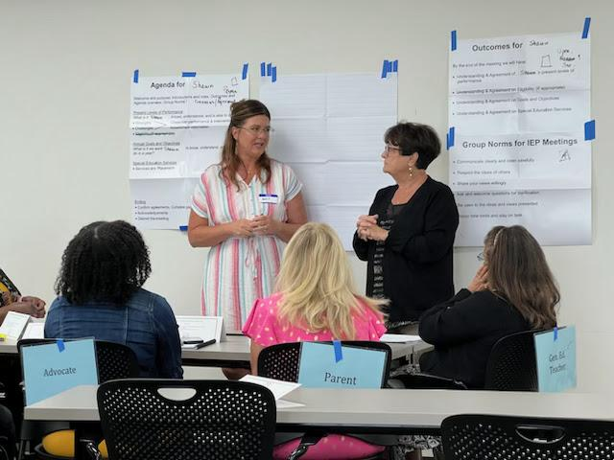
Introduction to FIEPs
A Facilitated Individualized Education Program (FIEP) is a “collaborative dispute prevention and resolution process used when members of an IEP Team agree that the presence of a third party would help facilitate communication and problem solving.”
FIEP is the same as any other IEP Team meeting, except that a facilitator joins the meeting.
Notes:
Define what FIEP is and how it differs from a traditional IEP process.
Highlight the importance of facilitation in promoting collaboration and reducing conflict.
Set the stage for how FIEP will be discussed in relation to supporting families, best practices, and building trust.

Slide 3
The Role of Supporting Families
Confidence
Information
Support
Notes:
Emphasize the importance of families feeling confident, informed, and supported during the IEP process.
Discuss the role of administrators and mentors in preparing families for these meetings.
Share how providing resources and clear communication can alleviate family stress and lead to better outcomes.

Slide 4
Strategies for Preparing Families
Early engagement and communication
Providing accessible resources and materials
Pre-meeting consultations or workshops
Notes:
Discuss the value of engaging with families early in the process.
Provide examples of materials and resources that can help families understand their role in the IEP.
Suggest hosting pre-meeting consultations to set expectations and answer questions.

Slide 5
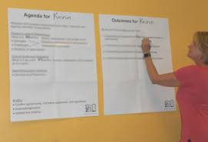
Best Practices for FIEP Implementation
Structured meeting agendas
Active listening and problem solving techniques
Collaborative goal setting
Notes:
Outline actionable best practices that make FIEP meetings more productive. (Agreements, ASPIRE, Agendas)
Discuss the importance of a structured agenda to keep meetings focused and efficient.
Highlight active listening and problem solving key tools to foster collaboration and resolve conflicts.

Slide 6
Integrating FIEP Best Practices into Your District
Training staff on FIEP principles
Creating and using FIEP-friendly resources
Regular review and feedback loops
Notes:
Mention region IEP team members being trained in the FIEP process.
Discuss the creation of resources and GaDOE materials that support FIEP.
Encourage continuous improvement through feedback from team members and families.

Slide 7
Building Trust through FIEP
Pillars of Trust:
Transparency
Consistency
Empathy
Notes:
Explain how FIEP can build trust between families and school teams.
Discuss the importance of transparency and clear communication throughout the process.
Highlight how demonstrating empathy and understanding can strengthen relationships and lead to better educational outcomes.

Slide 8
Success Stories and Impact
Examples of successful FIEP implementations
Hall County
GaDOE
Notes:
Share real-world examples of how FIEP has positively impacted families and schools.
Discuss specific cases where FIEP led to improved outcomes, reduced conflict, or strengthened relationships.
Use these stories to illustrate the tangible benefits of adopting FIEP practices.

Slide 9
Practical Tips and Takeaways
Key Takeaways:
Engage early and often with families
Use structured agendas and active listening
Focus on building and maintaining trust
Notes:
Recap the key takeaways from the session.
Encourage attendees to consider how they can apply these strategies and best practices in their own districts.
Provide a few actionable tips they can start implementing immediately.

