Slide 1
Why Blazing a Trail Matters
Holly Witcher, 2025 GaTOTY
Parent Mentor Kick-Off
September 12, 2024

Slide 2
Do You Really Make A Difference?
47,005 Special Education Teachers
209,985 Special Education Students
110 Parent Mentors

Slide 3
It’s Electric!

Slide 4
Mrs. Jane Grillo

Slide 5
Green Light

Slide 6
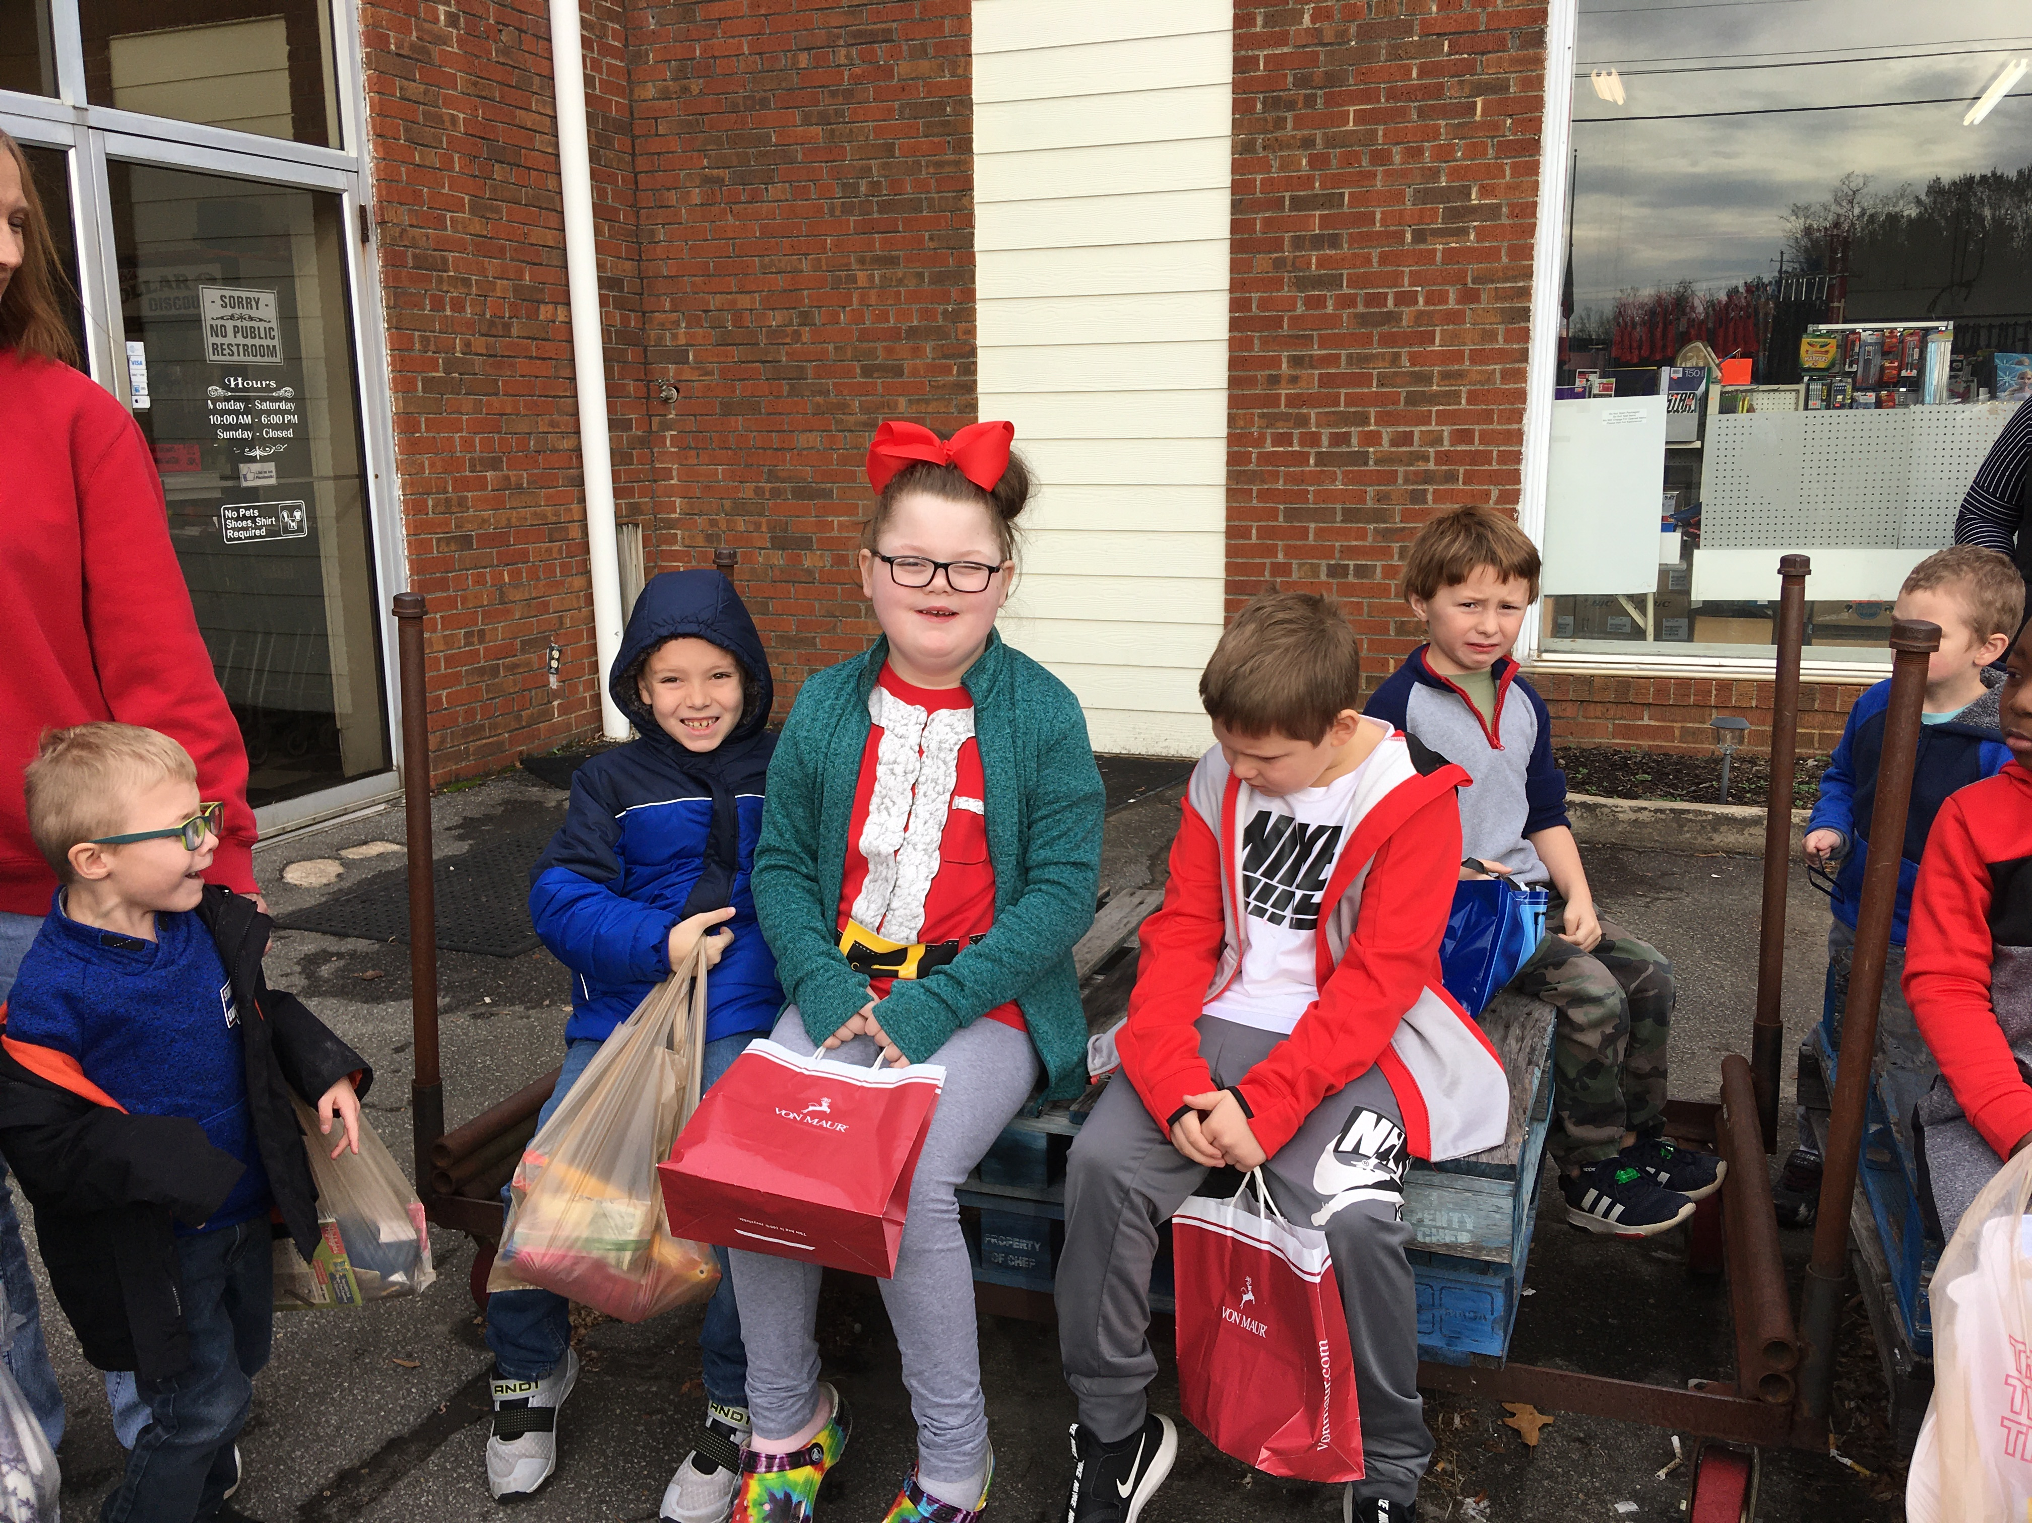

Slide 7
“I love a no. It forces me to be really creative.”

Slide 8
Success

Slide 9
Henry

Slide 10
#### Parent Mentors

Slide 11
Full Appreciation of Work Done
"More than 80 percent of supervisors claim they frequently express appreciation to their subordinates, while less than 20 percent of the employees report that their supervisors express appreciation more than occasionally."
Carolyn Wiley – Roosevelt University

Slide 12
Trailblazing

Slide 13
Structures of Engagement
Schools
Families
Communities
Students

Slide 14
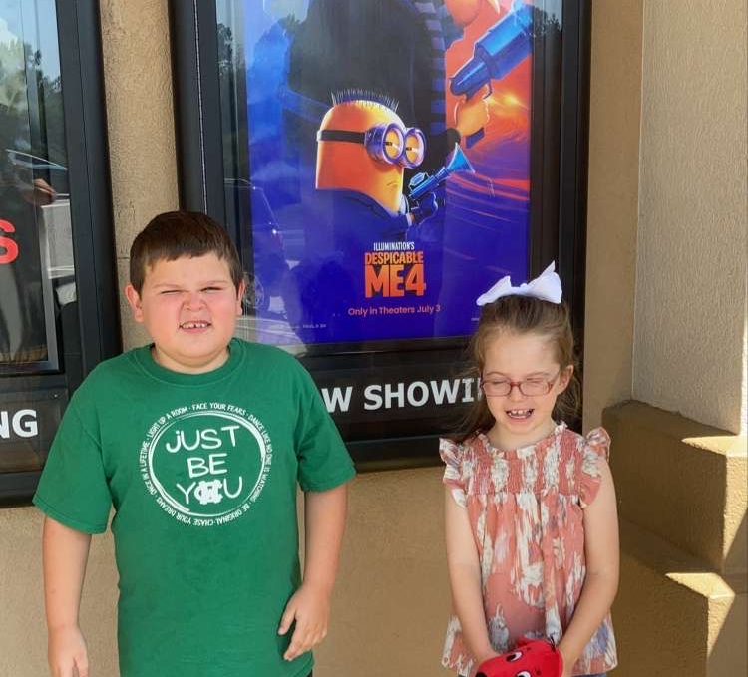
Mikey and Ava

Slide 15
Habersham Hills Cinemas

Slide 16
#### Parent Mentors

Slide 17
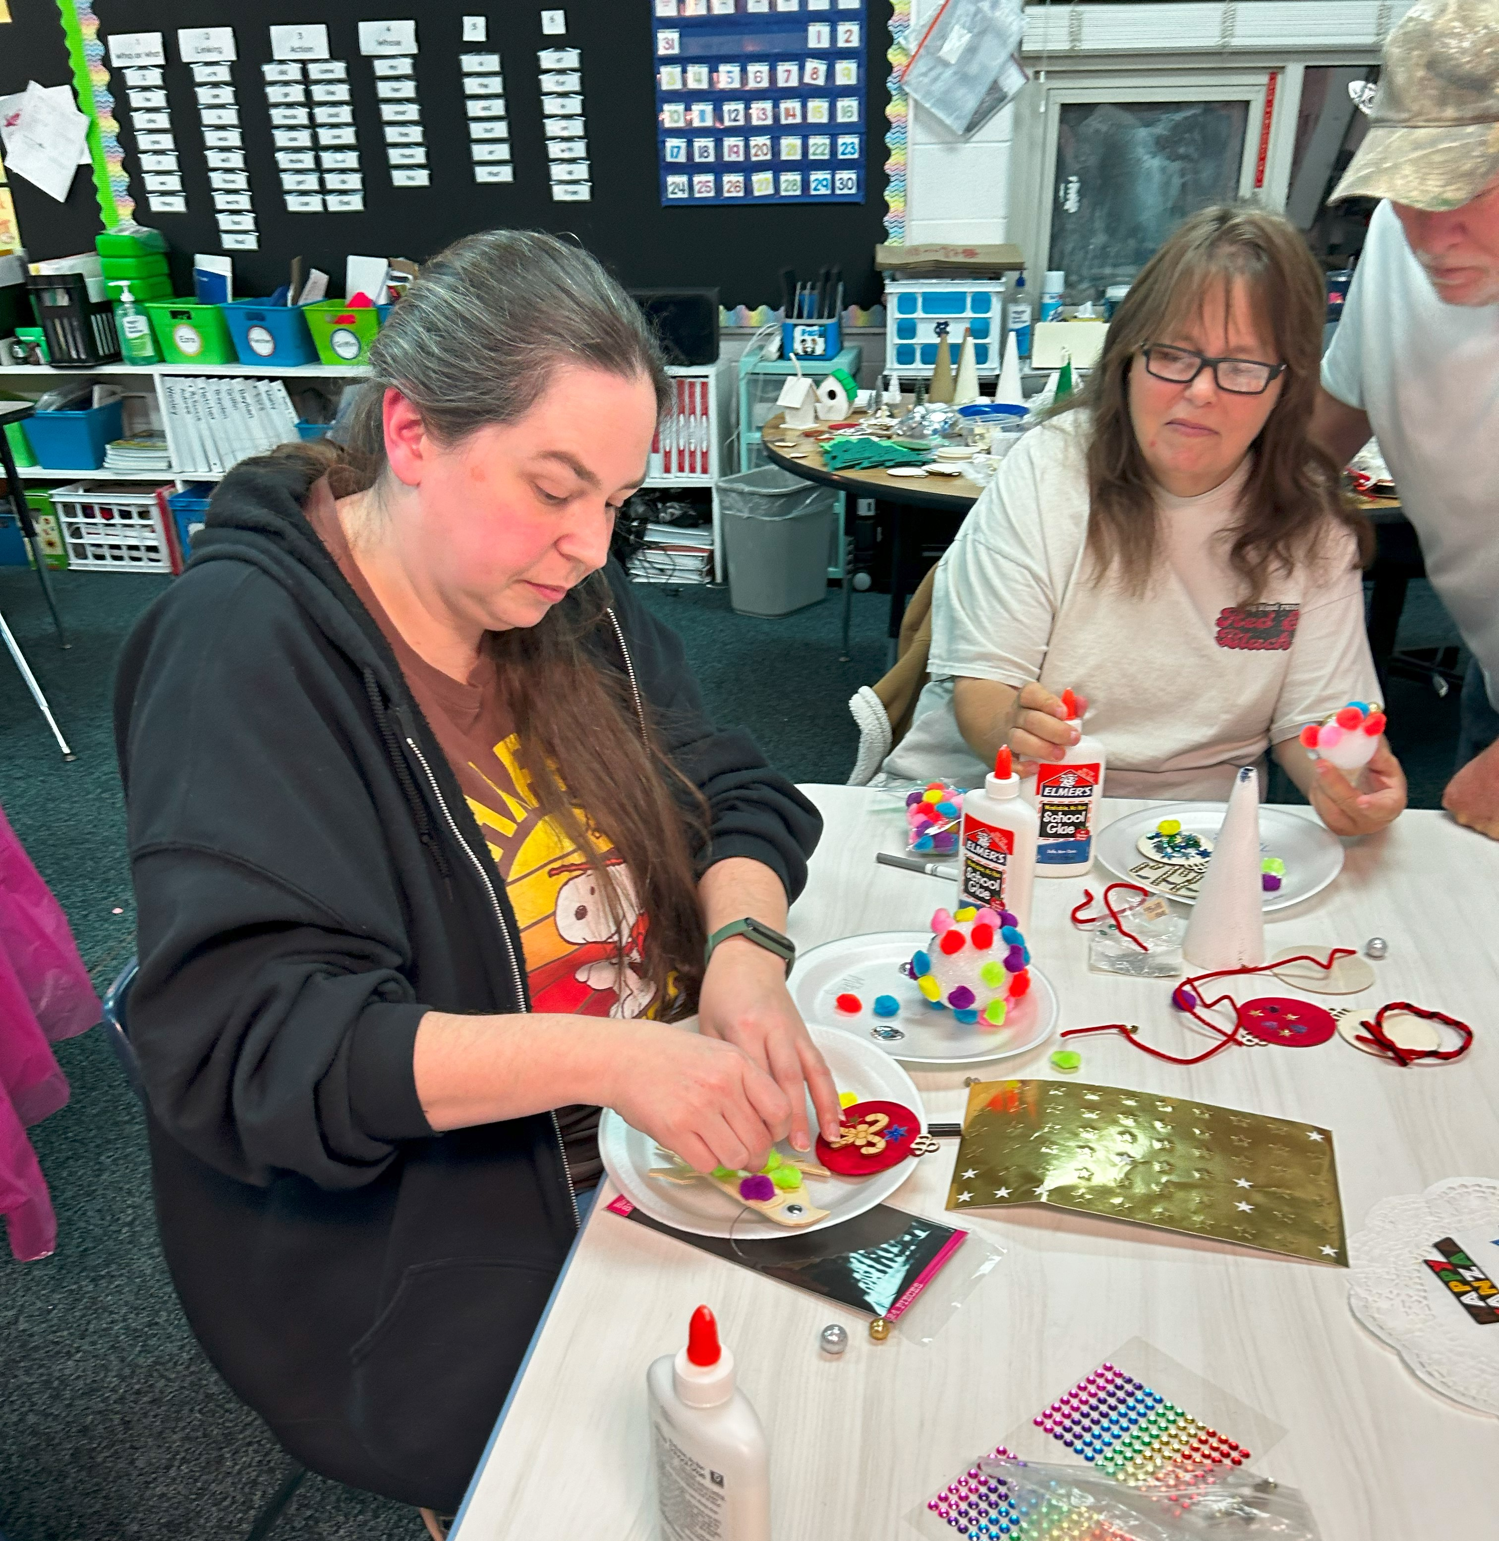
Relationships

Slide 18
#### Parent Mentors

Slide 19
Early Intervention

Slide 20
Parent Mentors
This Photo by Unknown Author is licensed under CC BY-SA

Slide 21
#### Parent Mentors

Slide 22
Public School

Slide 23
Counselors

Slide 24
Is It Really Worth It?

Slide 25
Be The Team

Slide 26
#### Parent Mentors

Slide 27
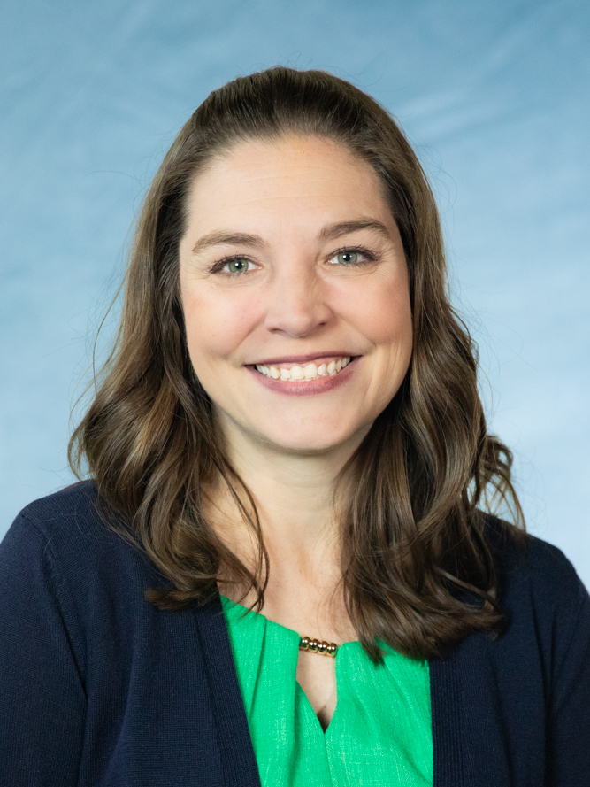
Contact Information
Holly Witcher
2025 Georgia Teacher of the Year
holly.witcher@doe.k12.ga.us
Twitter: @Georgia TOTY
Facebook: Georgia Teacher of the Year

